Slide 1

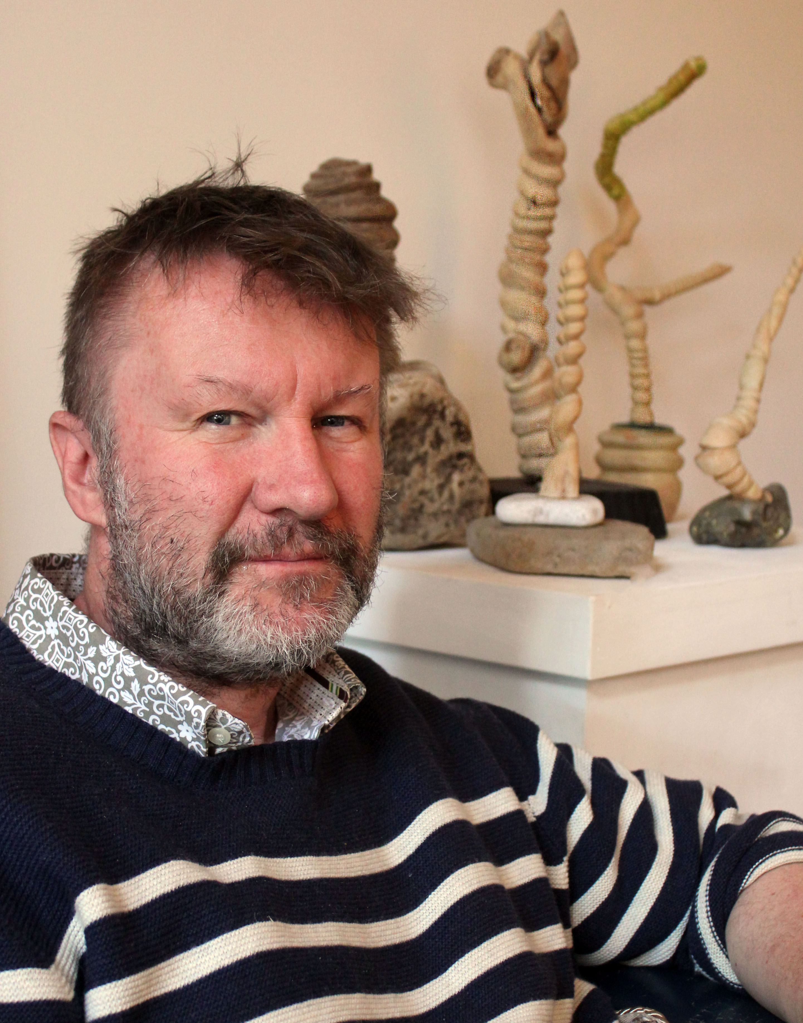

Stephen Kirin
Poetry and
Mark Making

Slide 2
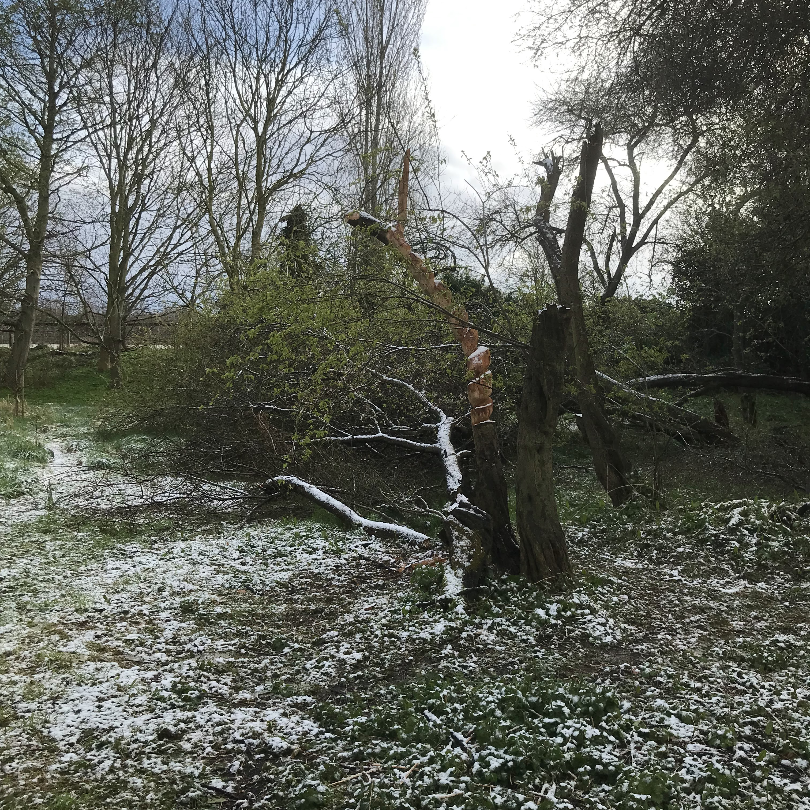
Eunice
Eunice slapped the old Greengage
Scattering old wood like pick up sticks
Pointlessly the severed bough blossomed
One last time
One last chime
Of the internal clock springs
Hammering at the door again
Cacophony of blossom
Blowing in the wind
Greeted me that day
Picking up the spiral
I carved the now deserted stump
Back to the sky
And we stared at each other
In the first warm weather
As birds of a feather do.

Slide 3
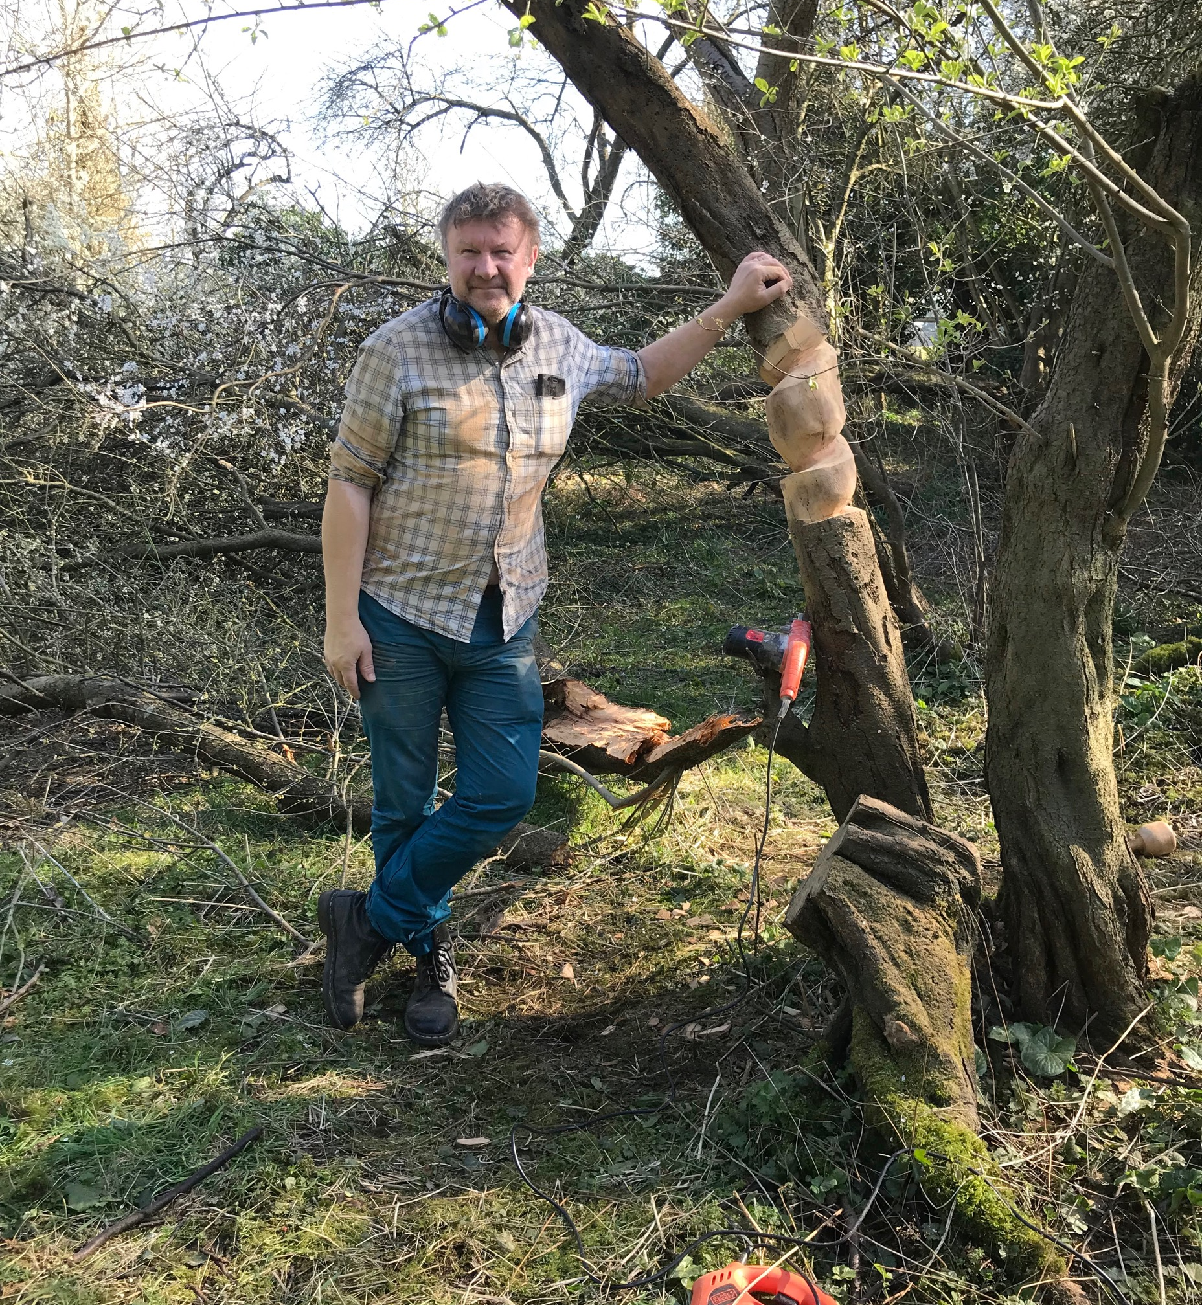
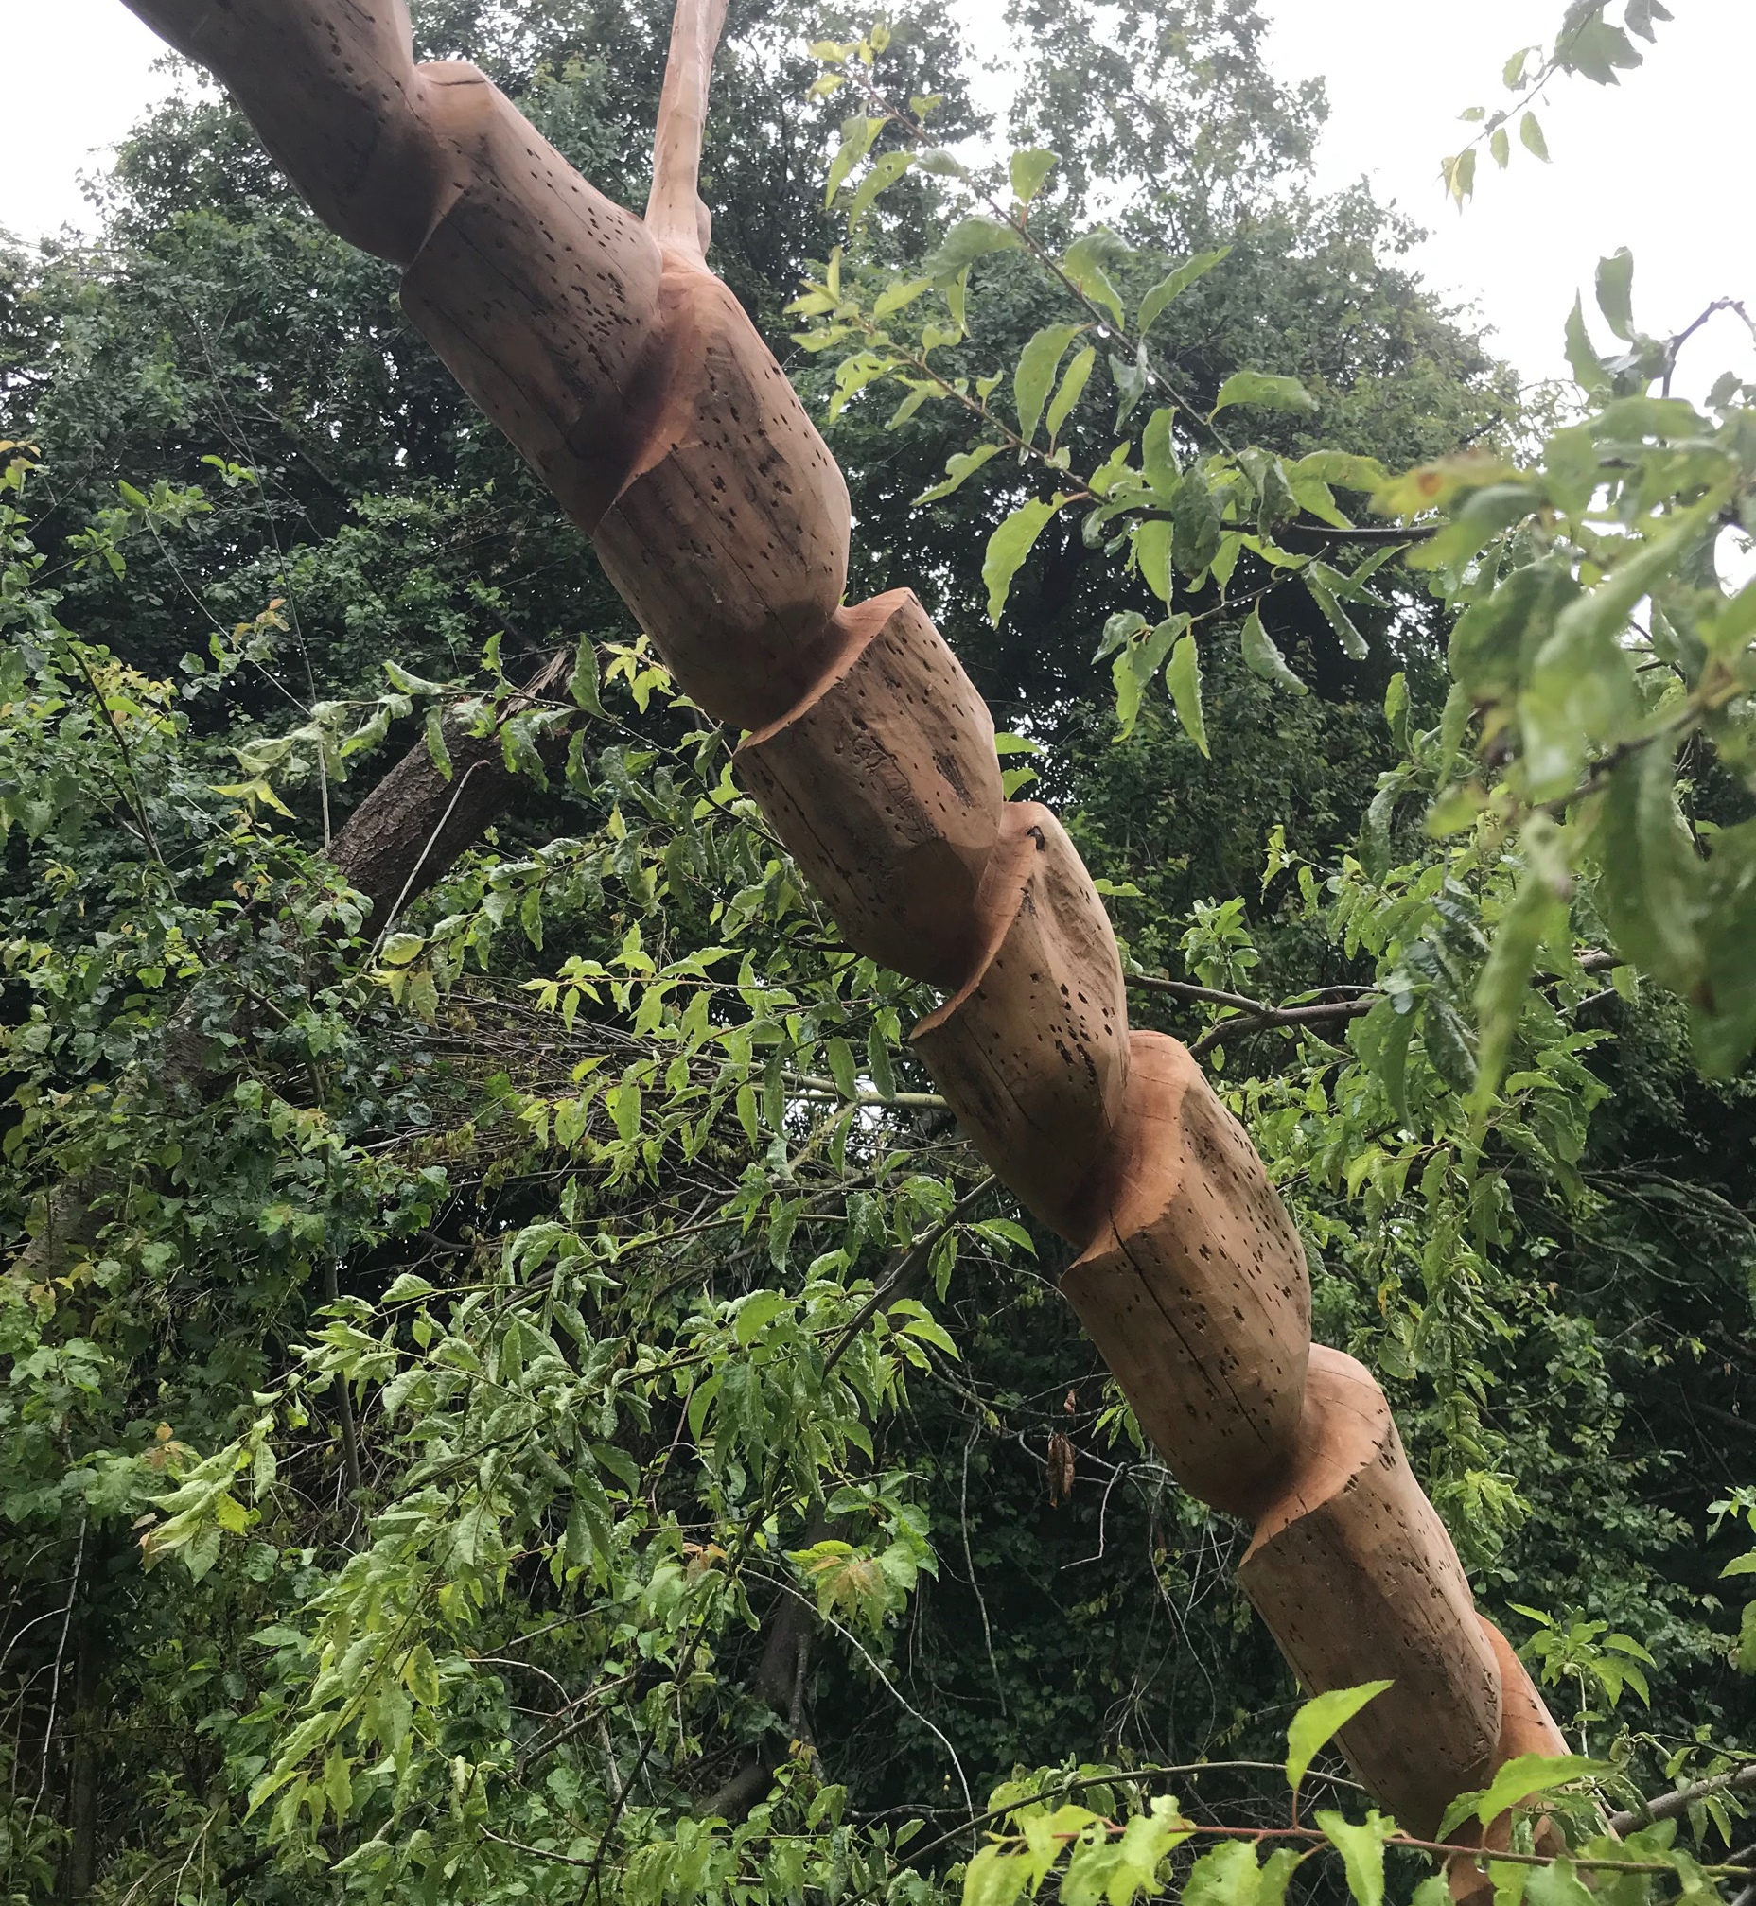

Slide 4
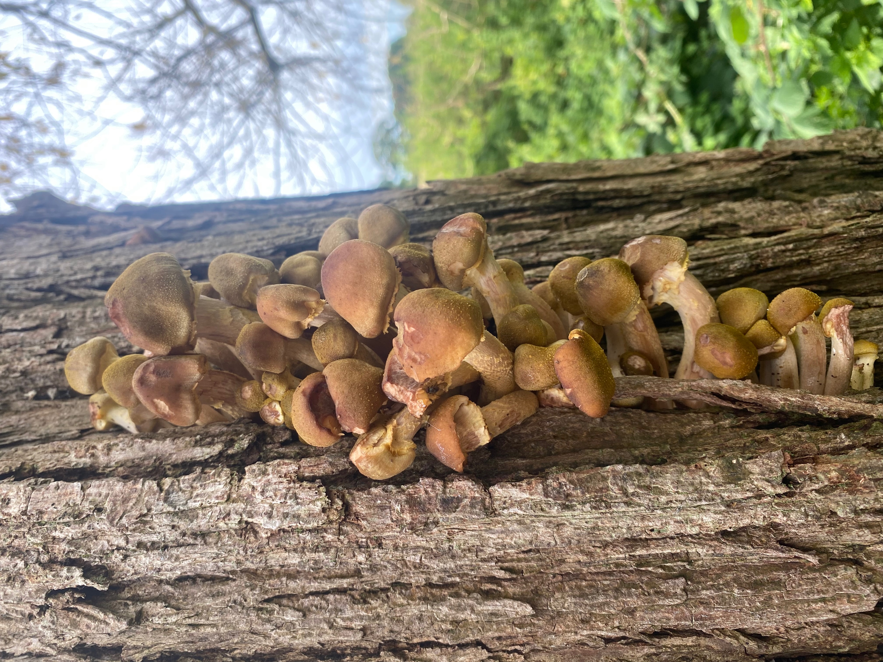
Willow
The Willow fell for the honey trap
Rhizomorphs have teeth
And the fungus army mashed the roots
Of Aspirin for the summer
The inflamed nation choked to death
Willow breath
But I dried the wood and tried my hand
At carving a rhythm she’d understand
The rings of her years
In the now hollow trunk
Dried up weeping Willow’s eyes
Circled away her strangled knot
And squared her pulse with life
Not forgotten not rotten
Very much alive.

Slide 5
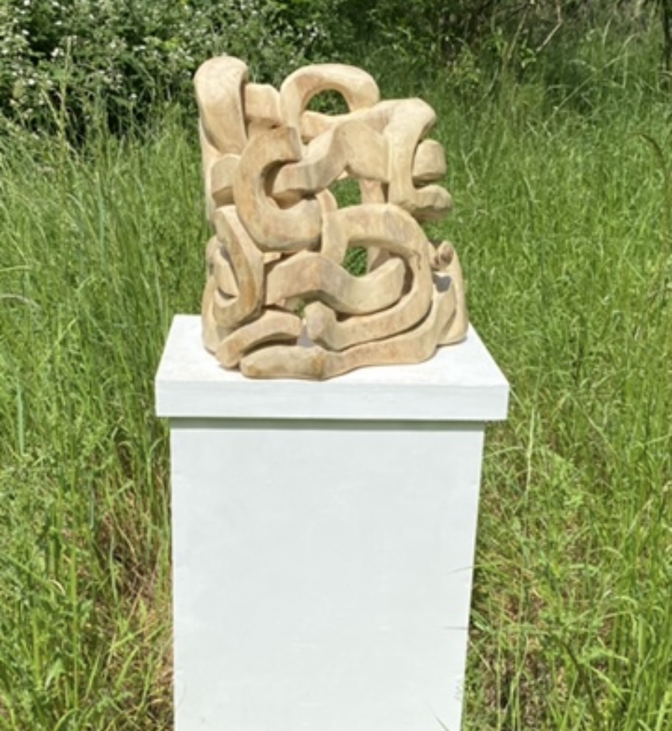
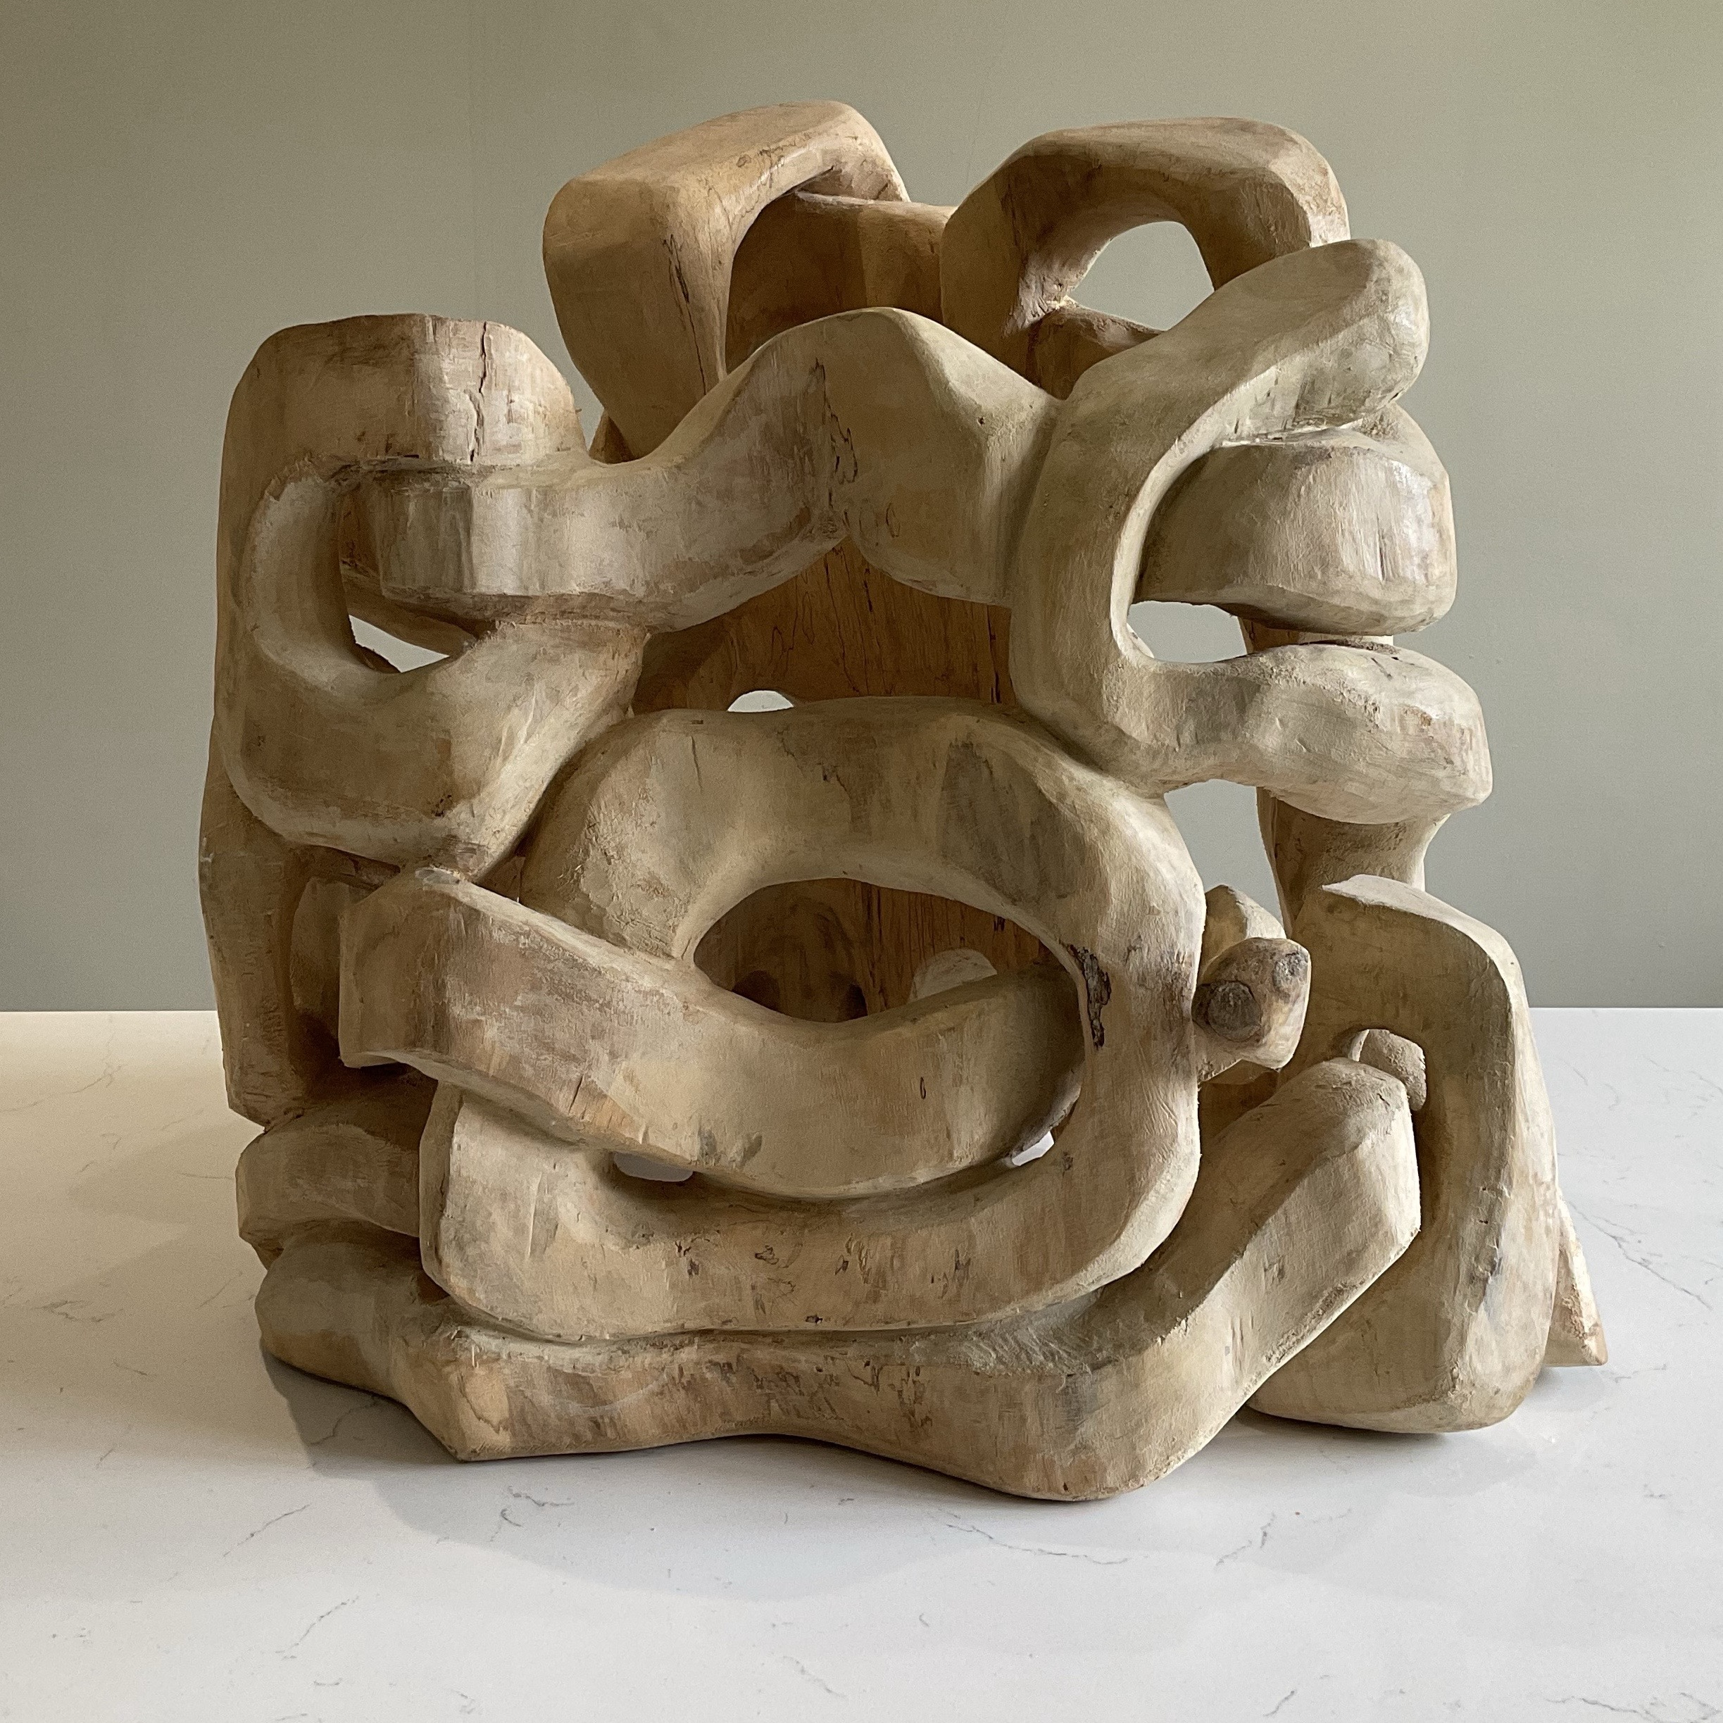

Slide 6
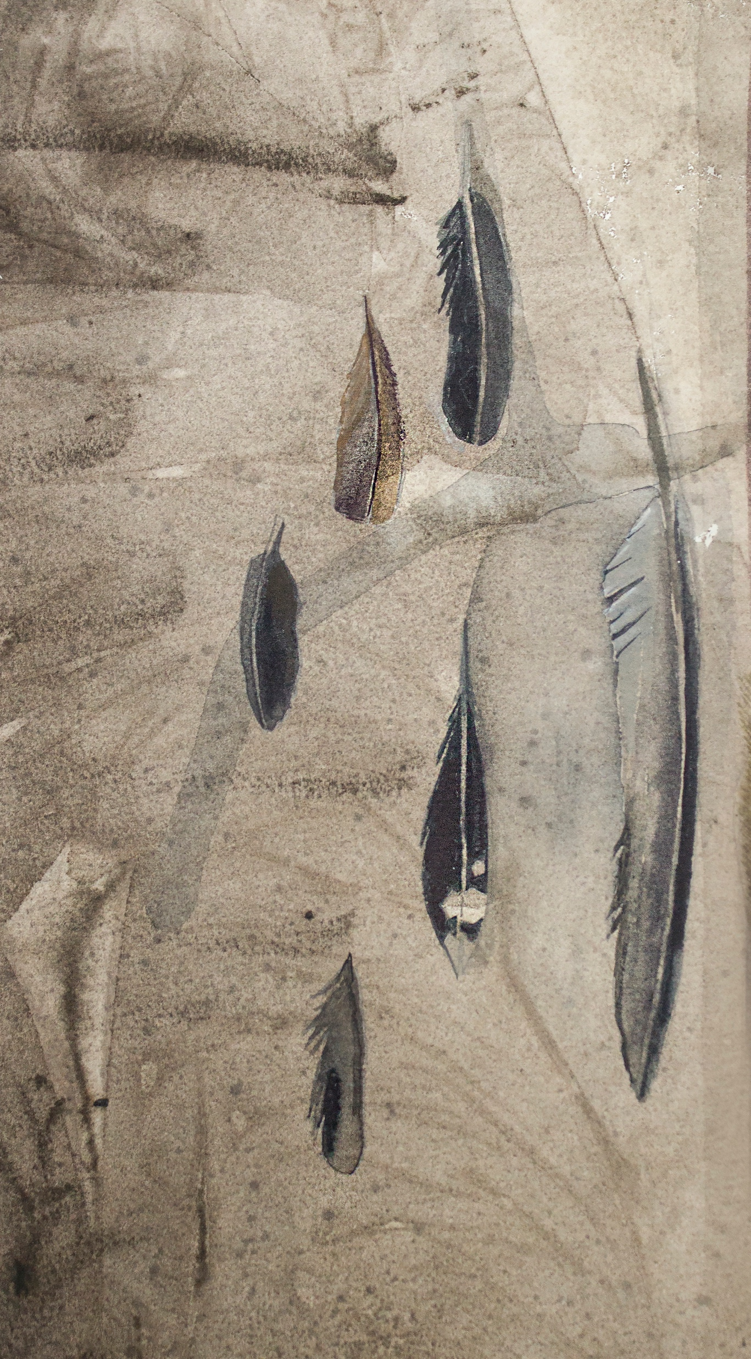
Feathers
It’s as if all the birds
In every weather
Had dropped every feather
The weight sometimes
Of all those whys
A ton of lead
Or a ton of words unsaid
Down on a feathered bed
The weight belies
The width of squawks
When the birds are dead
And they sing remembering
When a ton of song
Weighed the same as
Fly away Autumns’
Flu away fall
Feather or not
Bird at all.

Slide 7
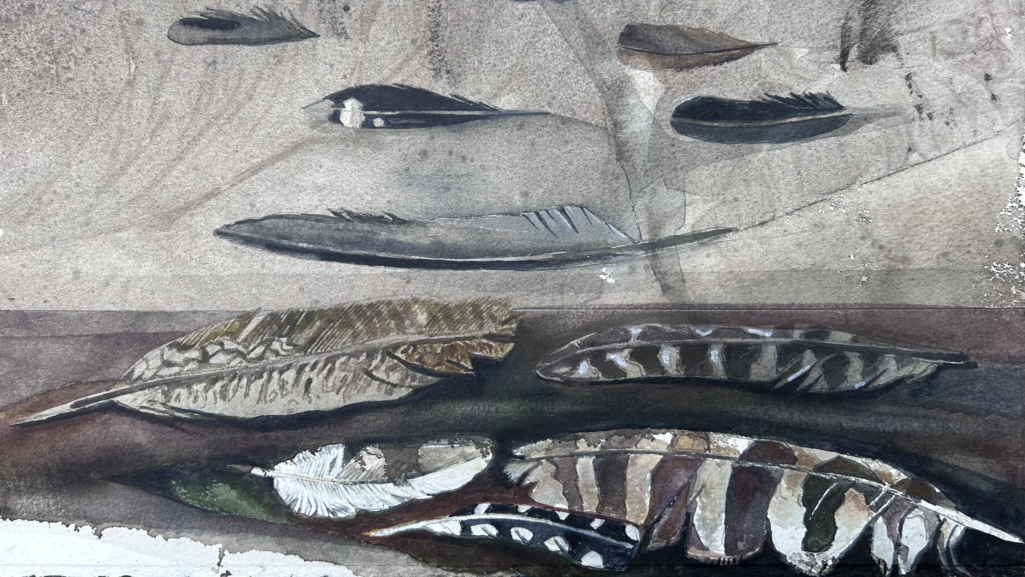

Slide 8
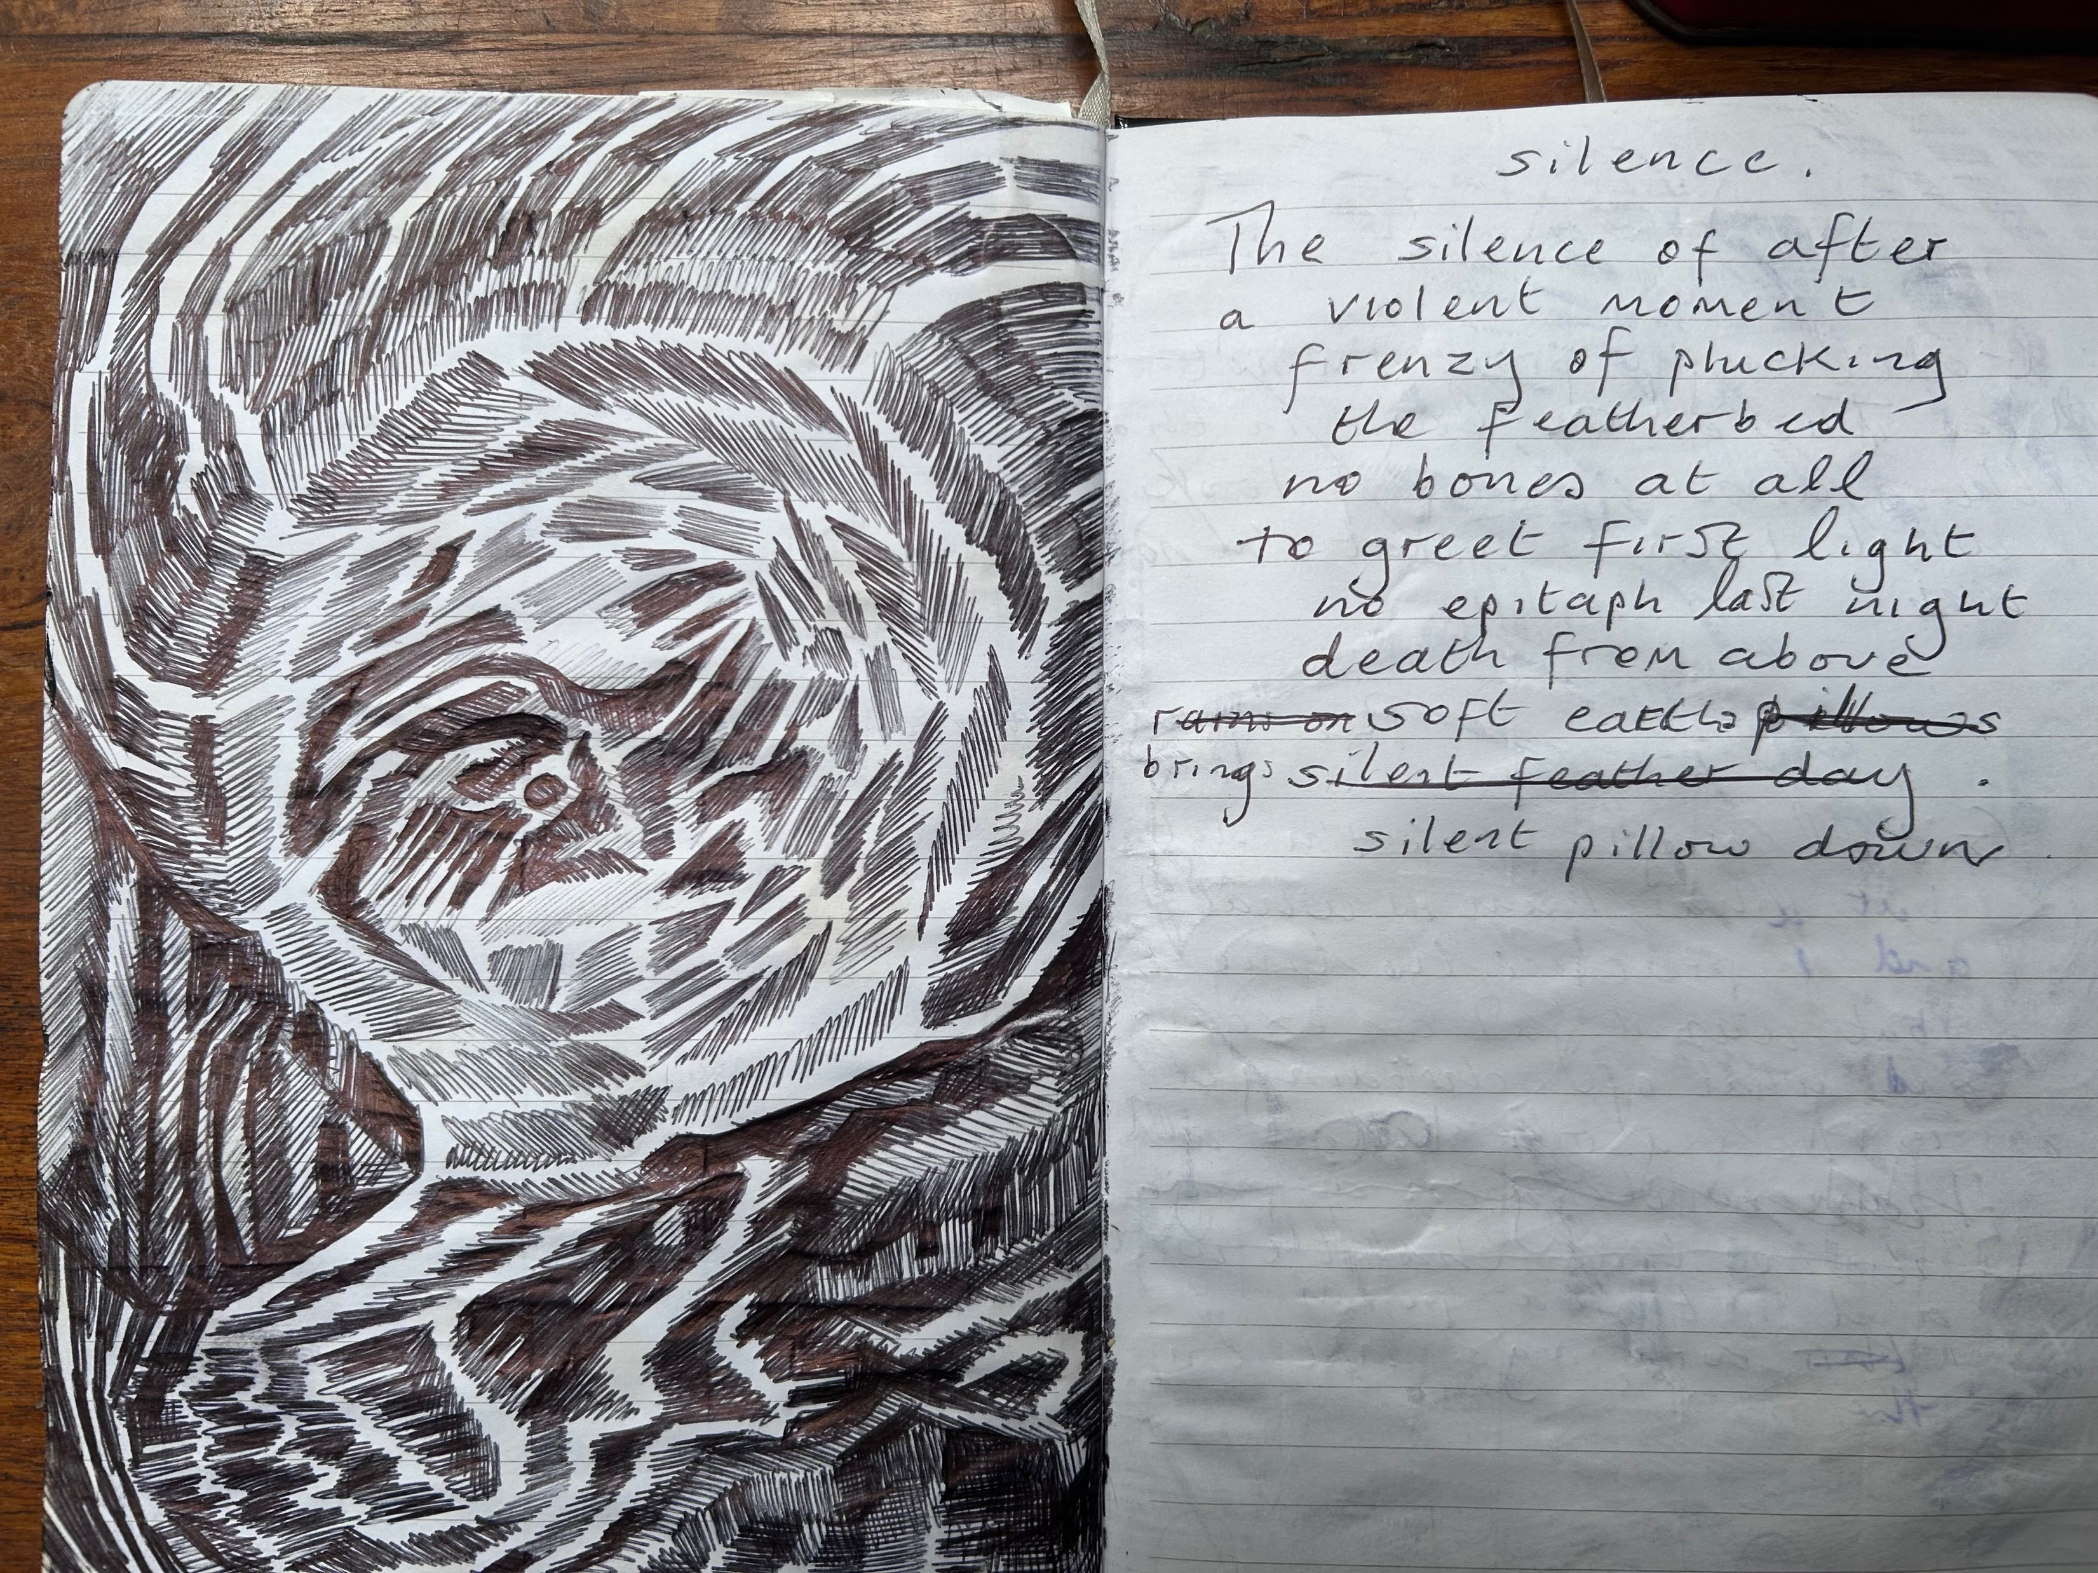
Silence
The silence of other
A violent moment
Frenzy of plucking
The featherbed
No bones at all
To greet first light
No epitaph last night
Death from above
Brings soft earths
Silent pillow down.

Slide 9
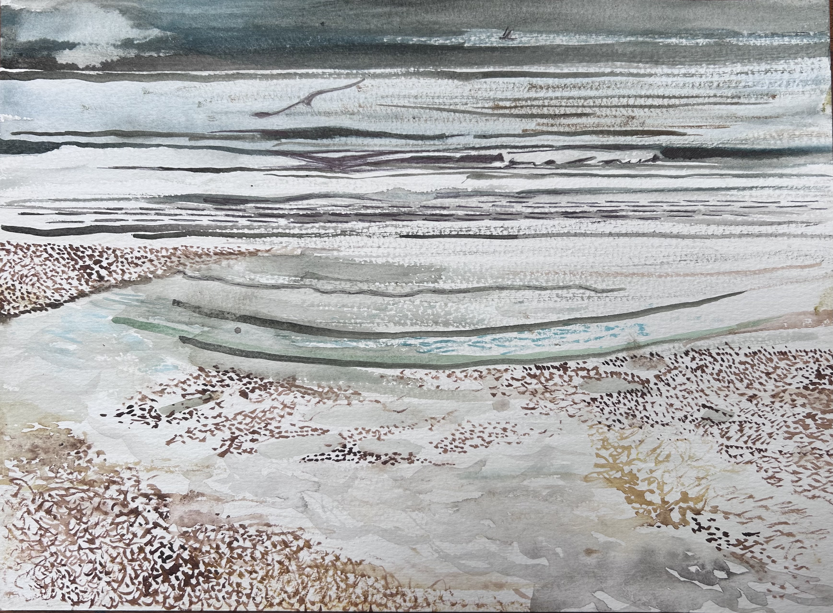

Slide 10
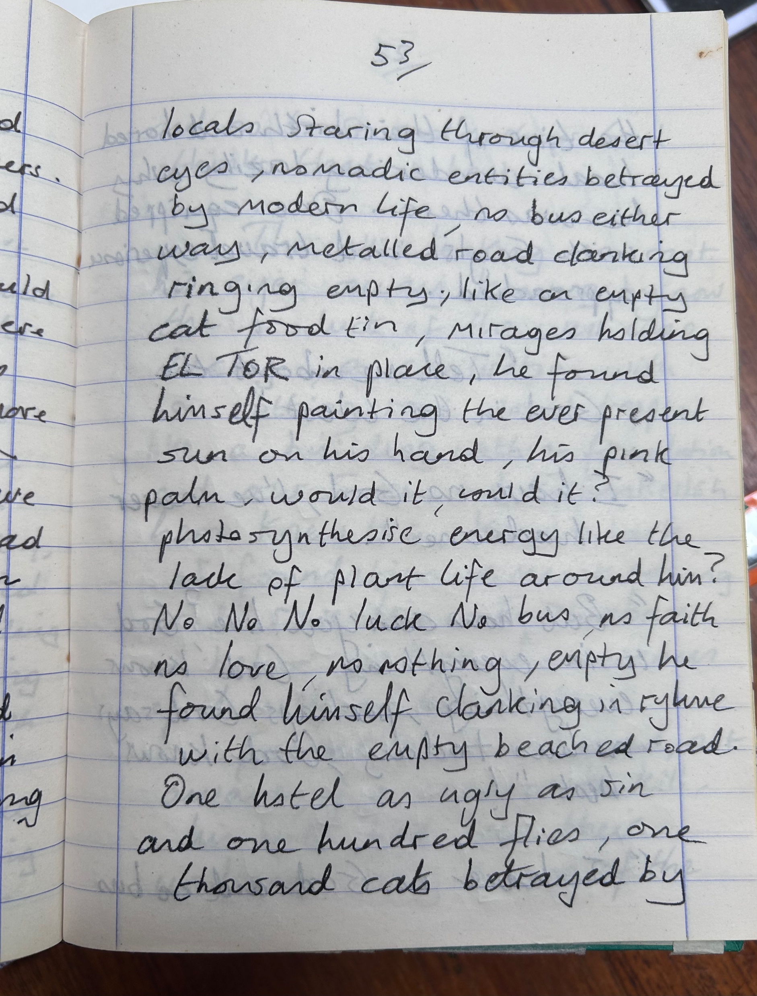
Cairo Memory
Dry and disappeared
Surrounded by children’s faces
A Scotsman said give them pens
The Citadel had none
But I bought a carved bird and started again
A concrete bridge with thundering traffic
And dirt underfoot
The gold mask of Tutankhamun
Driving us away
From the Hotel Mayfair to introduce
Us to his brother
In a place far away from Garden City
And another who sold me fake perfume
As a keepsake of my stay
Sitting on the bus
From the museum to Giza
Scarabed in the corner by Nile’s people
Took me to the Pyramids on Christmas Day.
The brown Nile flows by Zamalek
And old Boulak bridge shook it’s timbers
On Gezira juice
To an aisle of Bombay mix with dates
In islands of the sunny Sudanese
Markets tune
Humming Hotel Windsor’s panelled cool
Sent a boy off for a seat to Sinai
He returned too soon across
The swirling circle
In the city’s belly where the black and white
Taxis roam
Spewed fumes as the Sobia was stirred
By a careful old man in the crowd
After too much beer
In the Hotel bar on Tahrir Square
With a Canadian called Dry
We walked to the Marriot for American dollars
But got a belly dancer’s eye in the Sinai
In the dark alley Canada drank everything

Slide 11
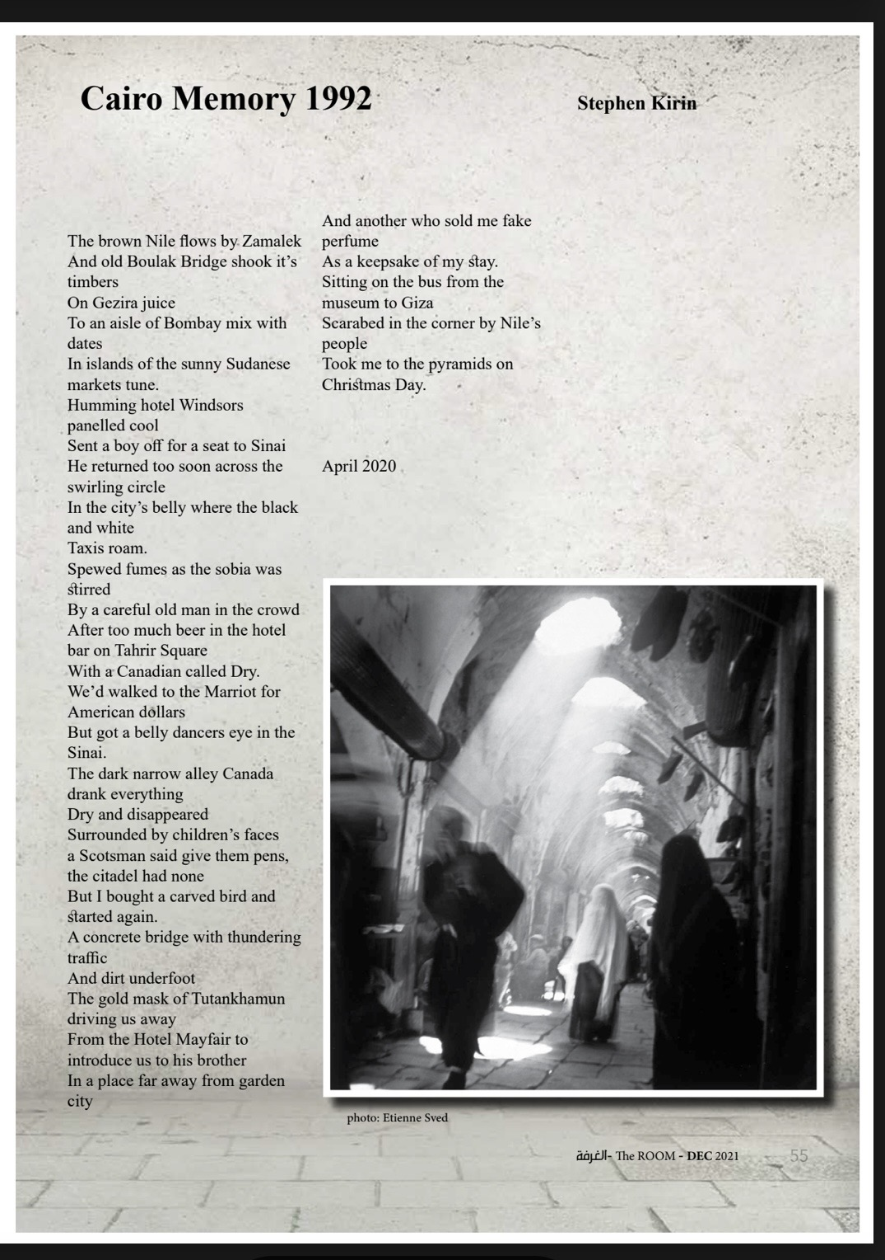
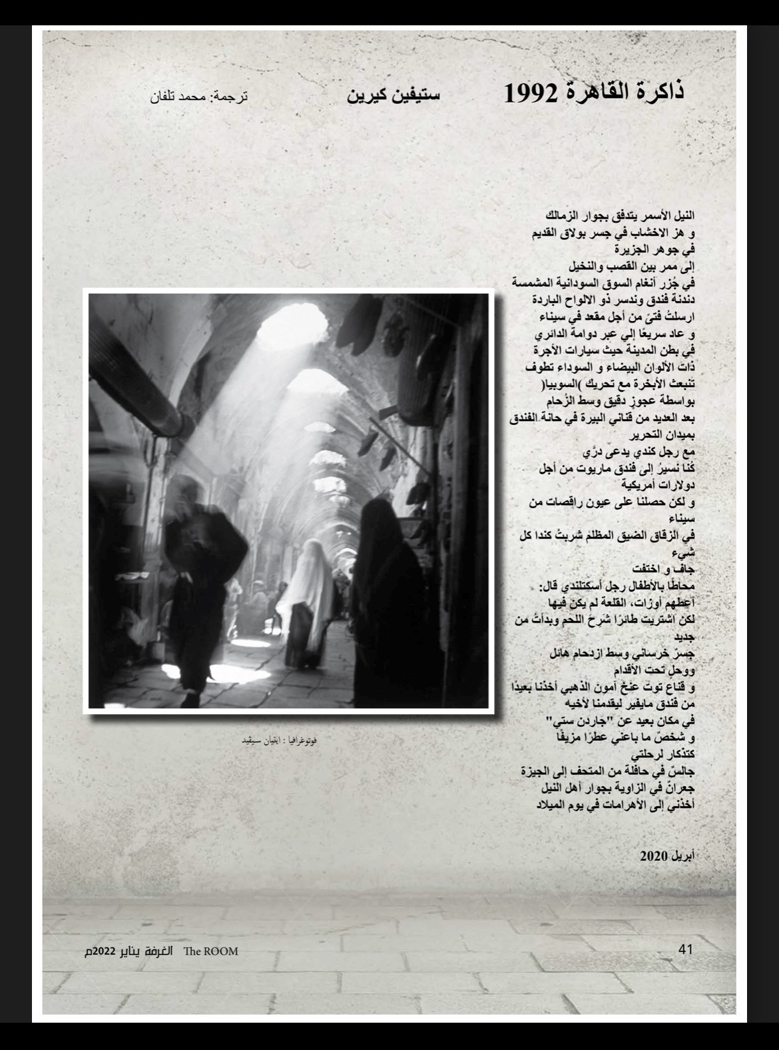

Slide 12
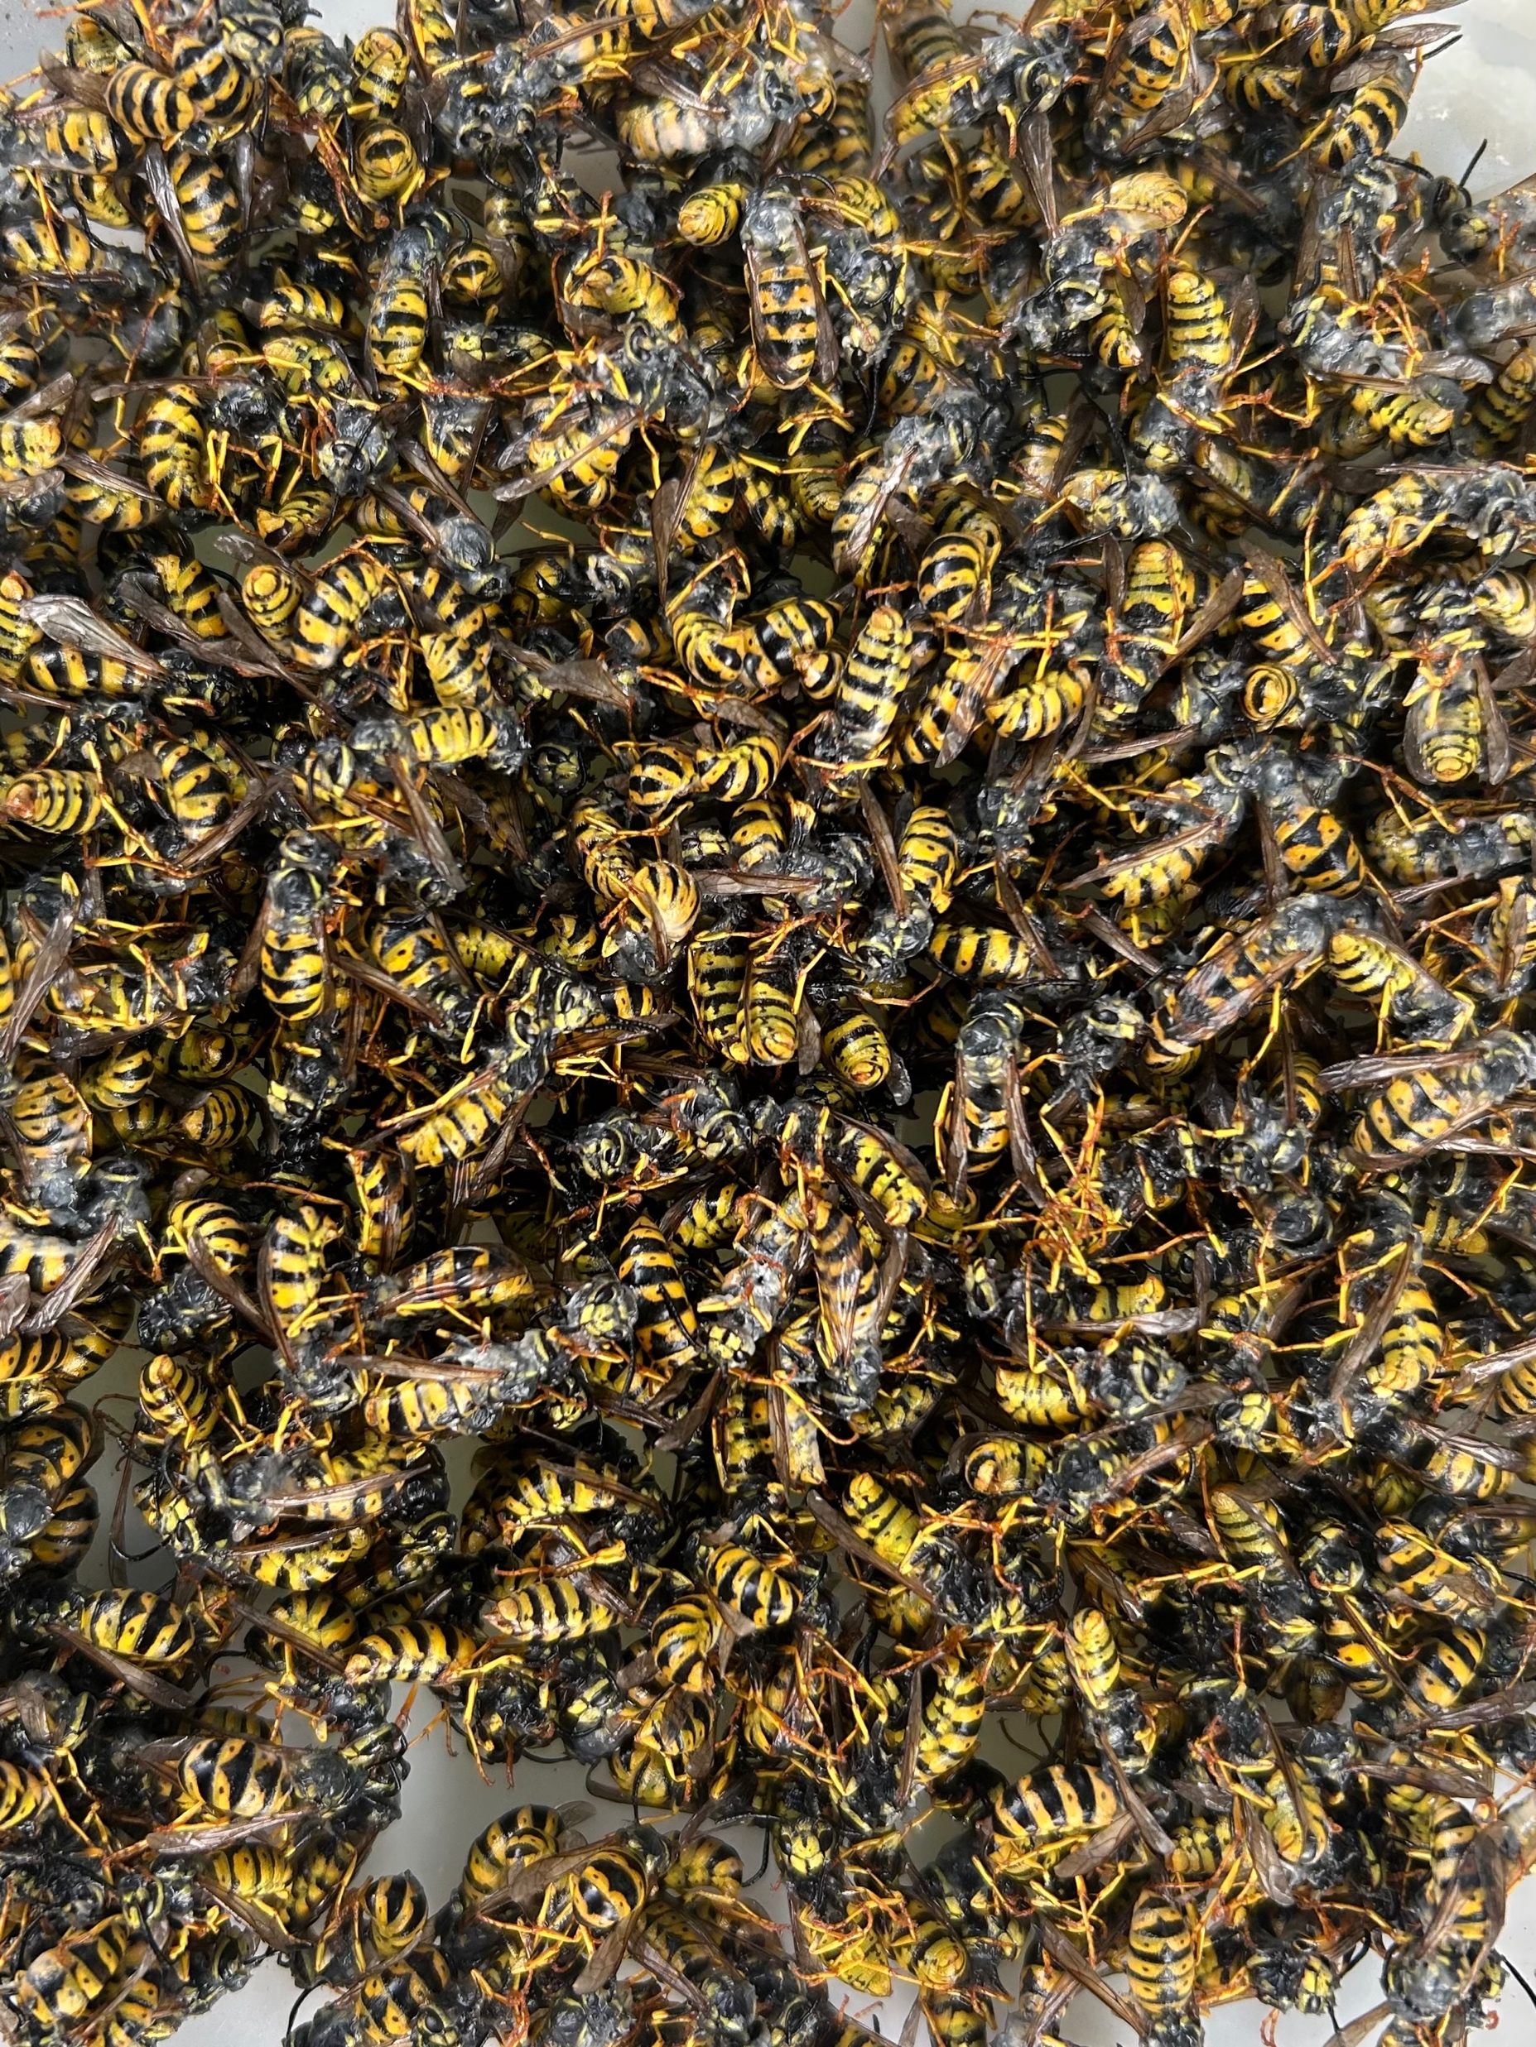
The Badger
That song scent bright
The wasps made the brain again and again
A compartmentalised buzz for a nose
Badgered up the food chain
And the Mycorrhizal audience’s
Fungi humour spread
Puffball spore fleshed
Past moonlight flicked
The rain frown brain
Back and forth left and right
A Melee Meles olfactory Pele
Under Oak blown leaves
Zig zagged the Badger’s
Song sent night.

Slide 13
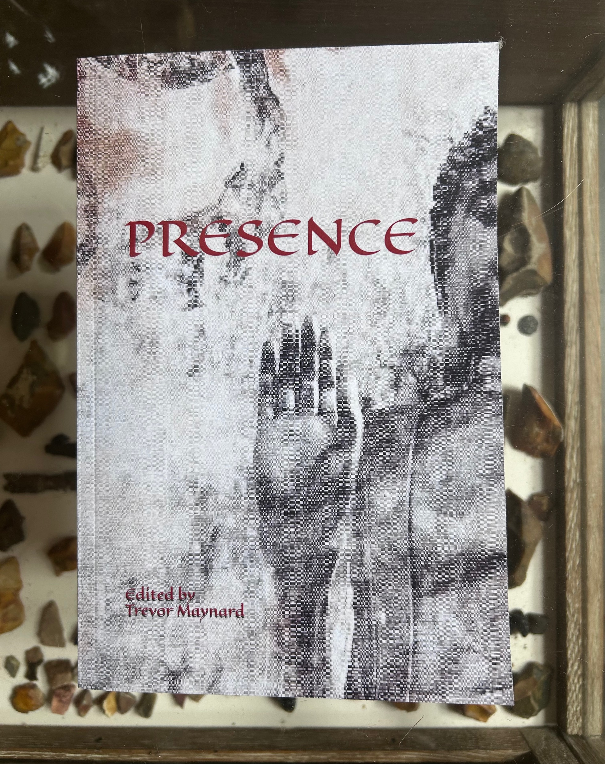
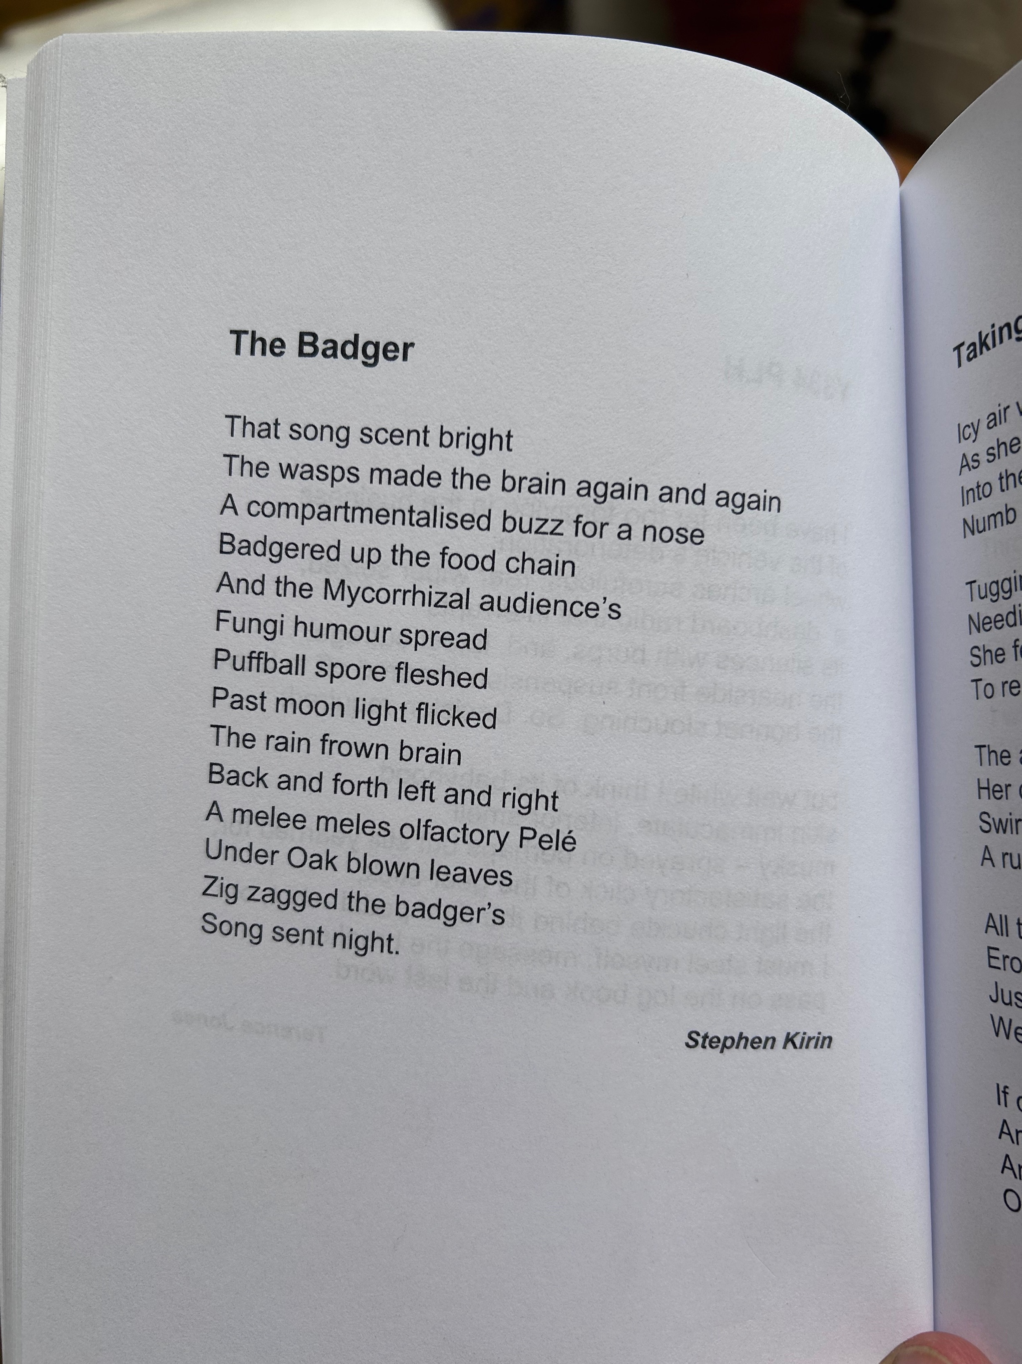

Slide 14
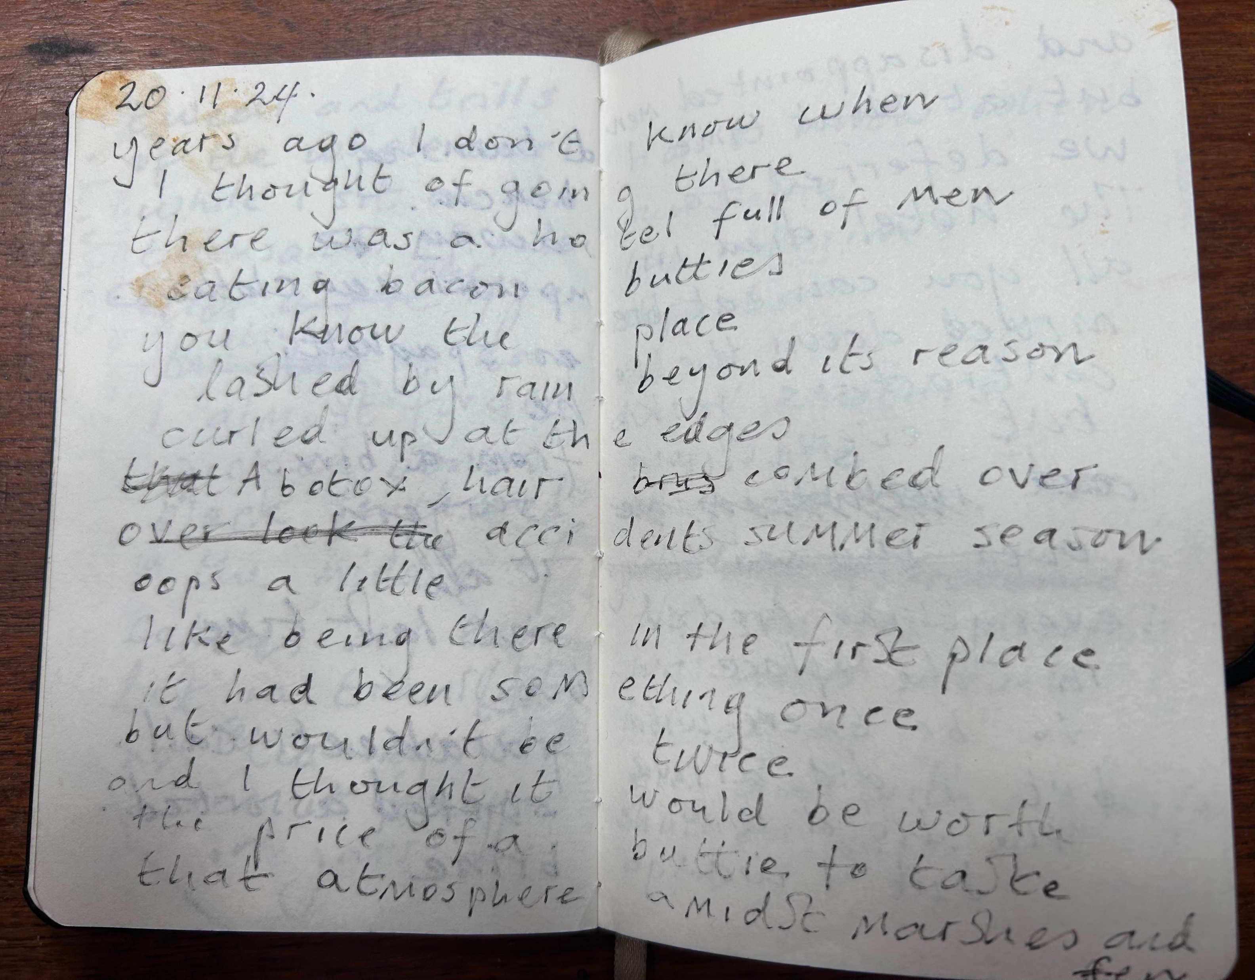
The Hotel
Years ago, I don’t know when
I thought of going there
There was a hotel full of men
Eating bacon butties
You know the place
Lashed by rain beyond reason
Curled up at the edges
A Botox, hair combed over
Oops a little accident summer season
Like being there in the first place
It had been something once
But wouldn’t be twice
And I thought it would be worth
The price of a buttie to taste
That atmosphere amidst marsh and fen
The curled up men shouting at the sea
Swirling round the interim of their cup and saucer
Mud in the wake of it’s mistake
And when I washed up on that shore
For real actually there
The hotel had gone to sea
Lost property waving at me.

Slide 15
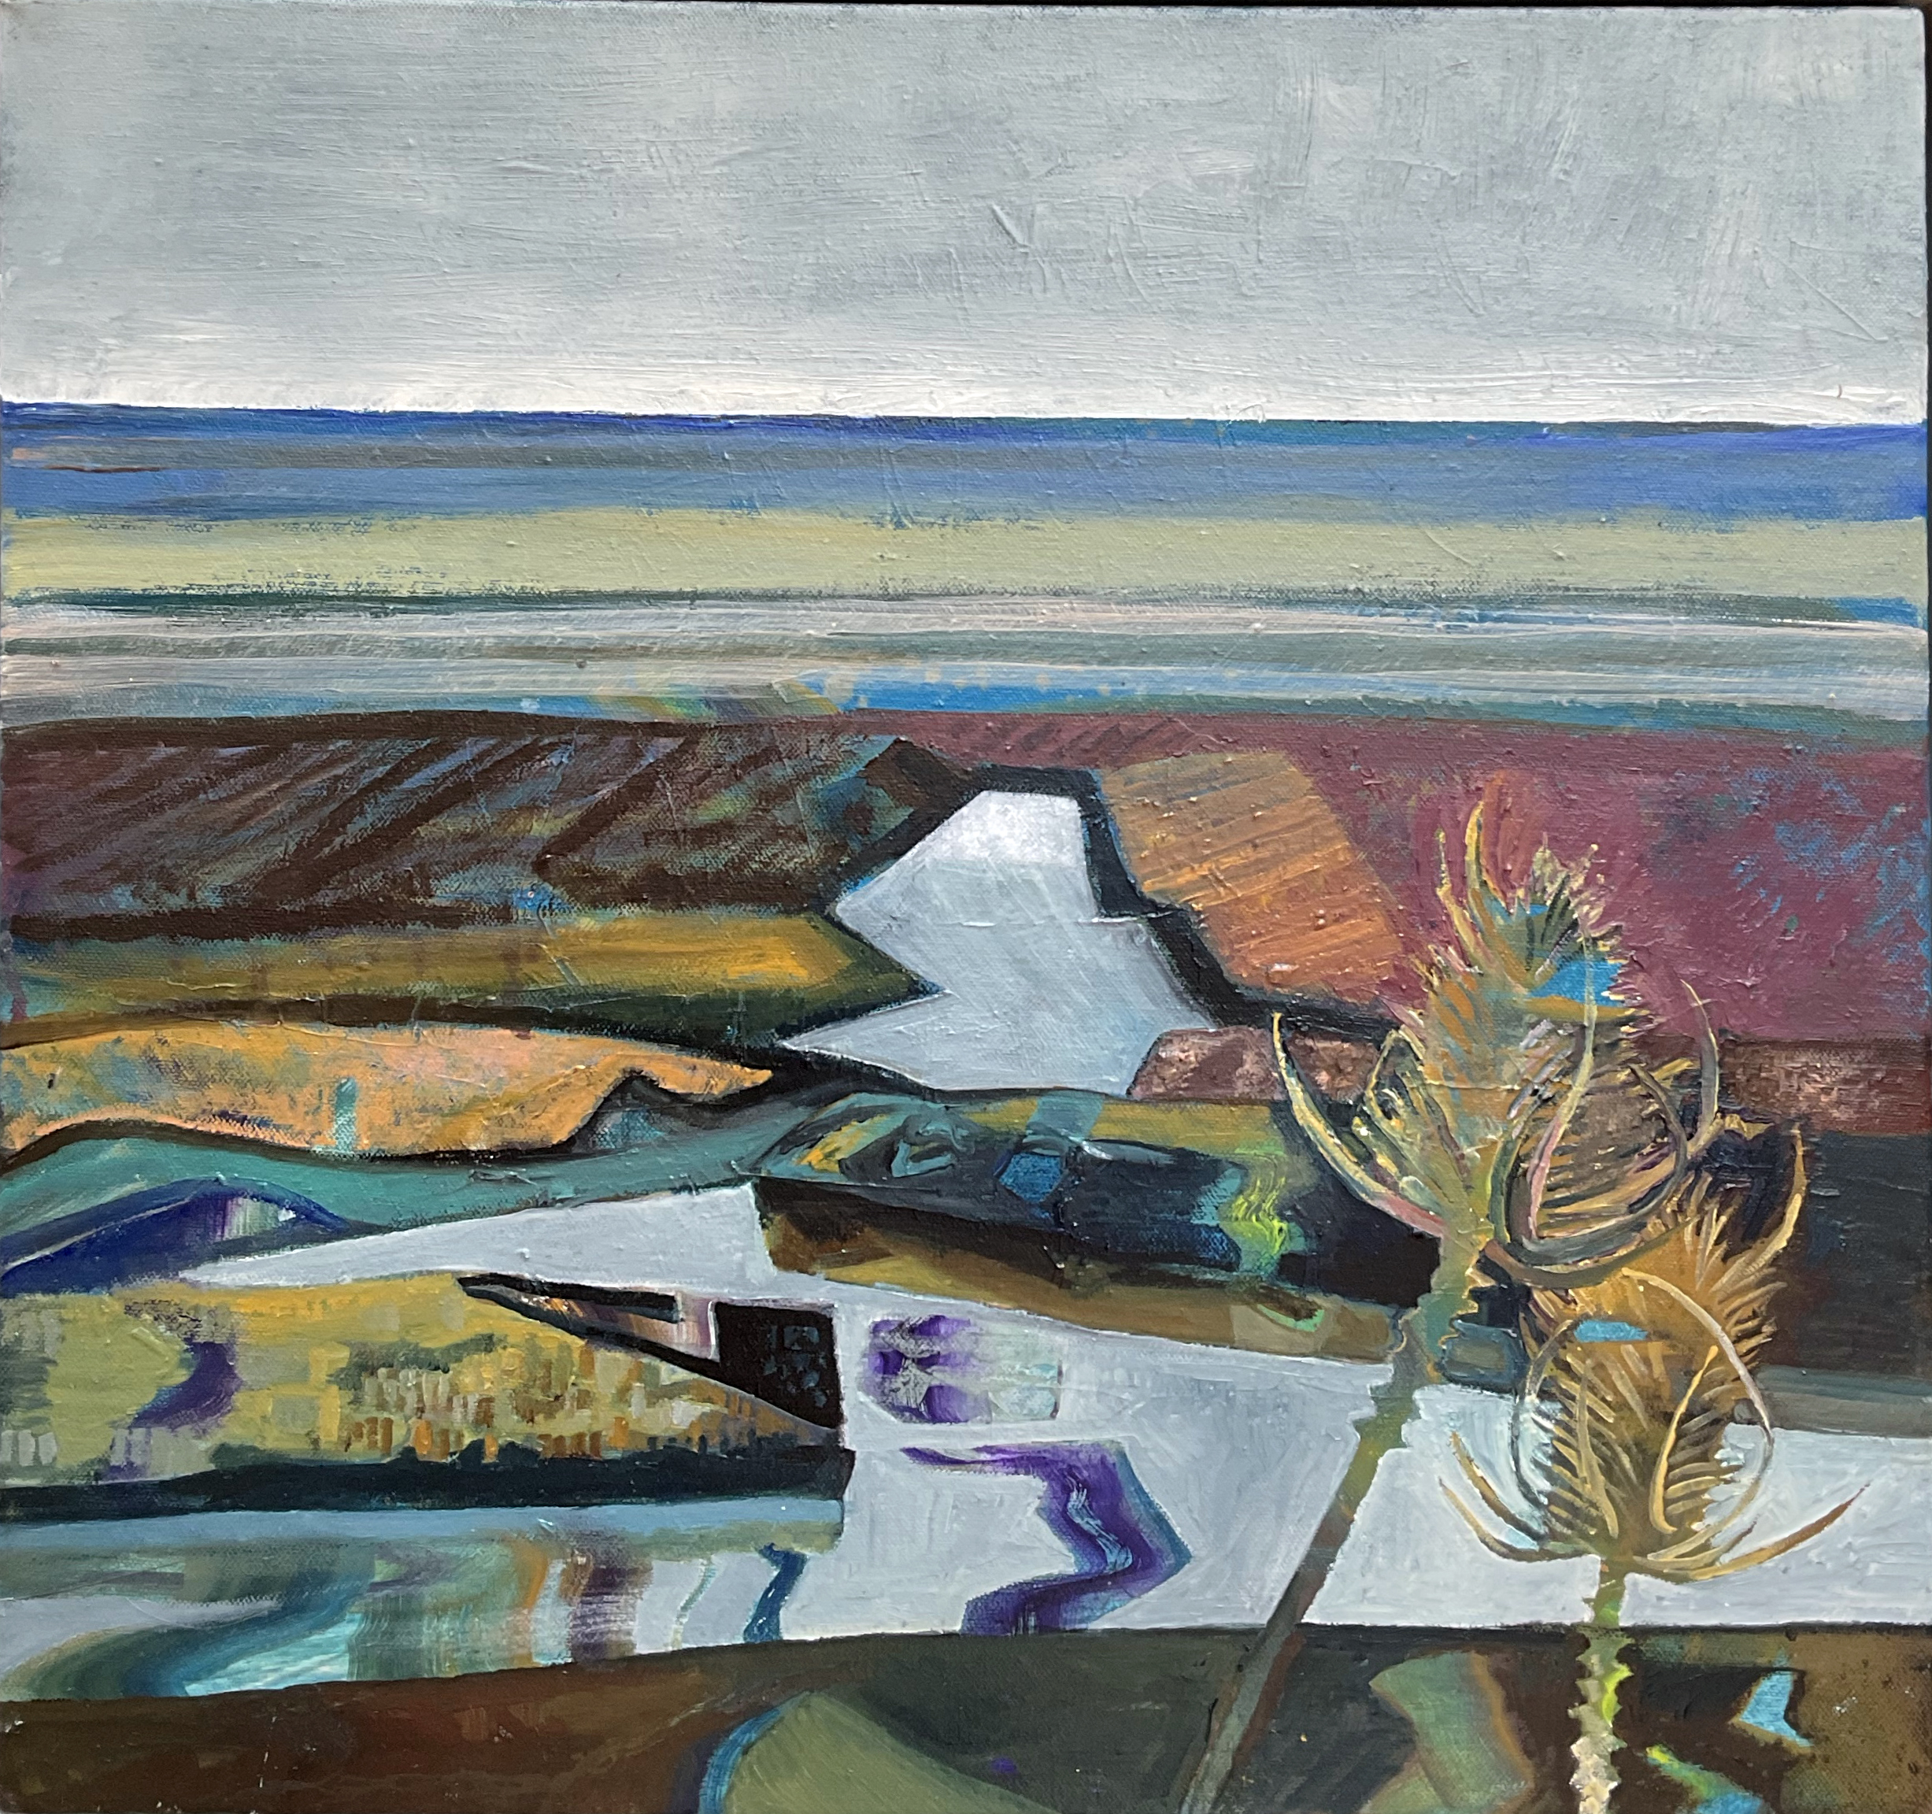
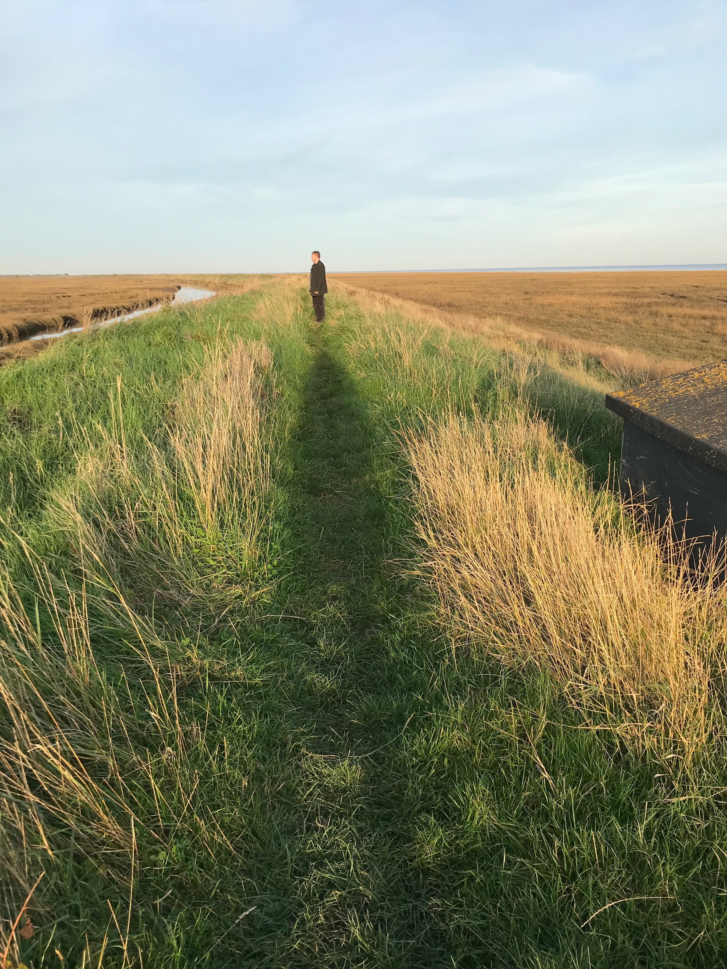

Slide 16
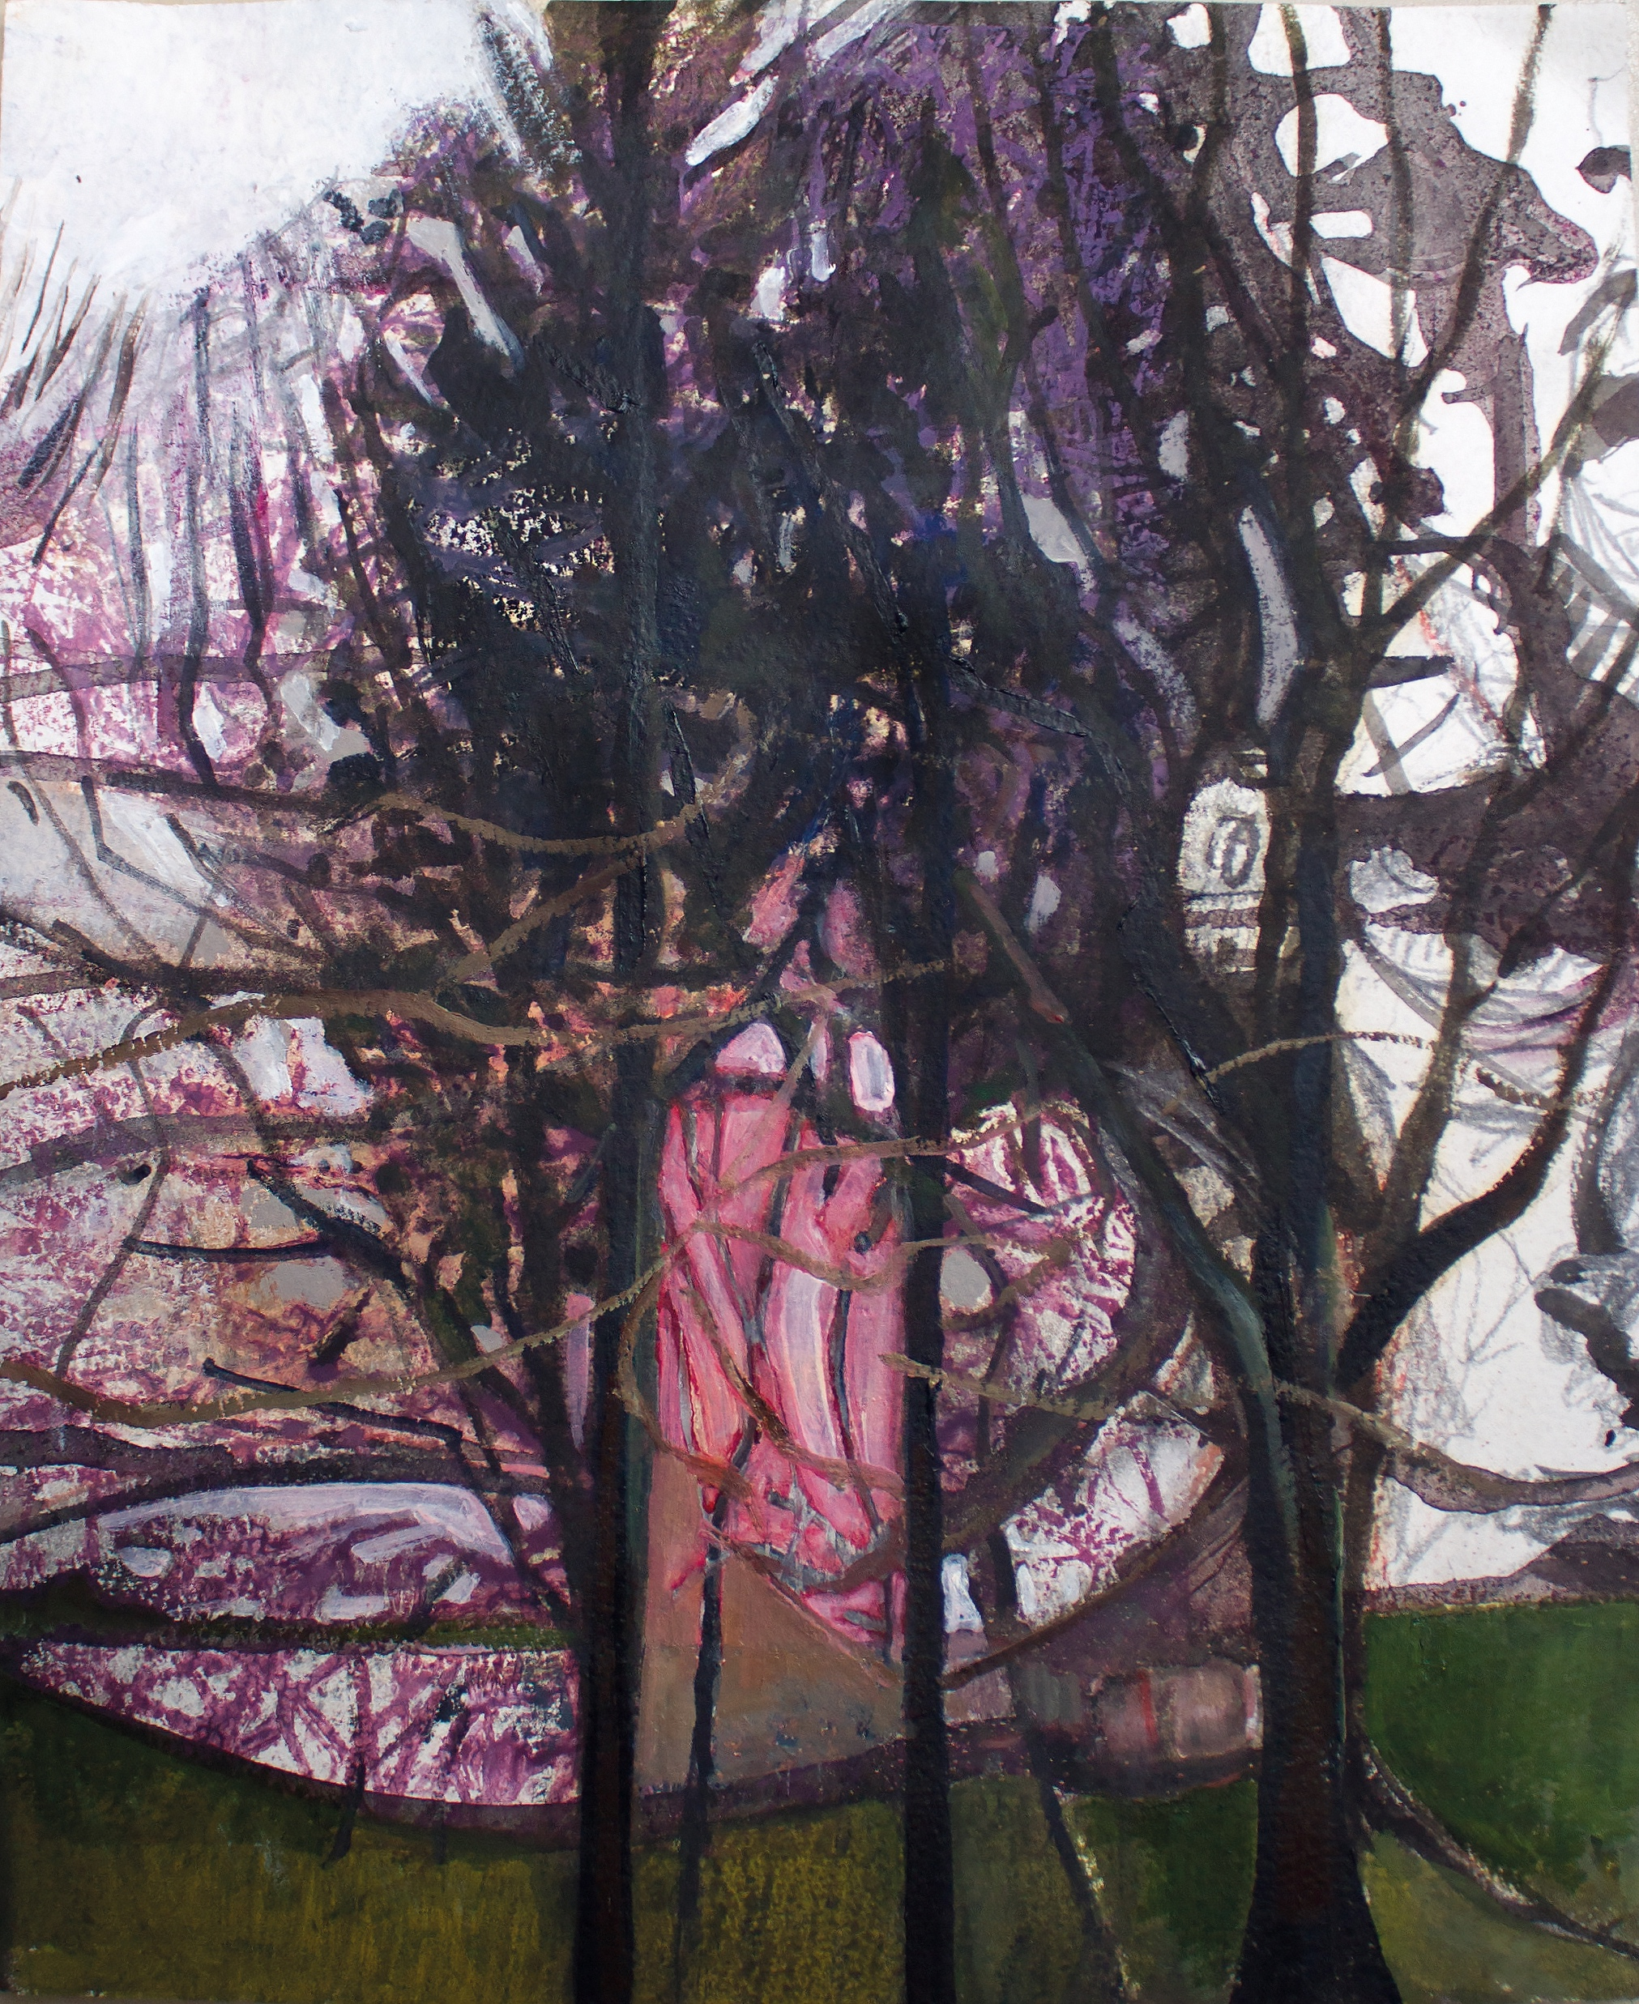
A Carved Heart
A poem within a poem, within
The Snail helicopter
That disrupted traffic
At the old man’s airbase
I spoke about looking and following lines
For some it’s the curriculum
For some it’s time
Walking on the ha-ha
Laughing in nettles
A walk within a walk, within
Birdsong scaffolding
Slowly revealed a carved heart
On a beech as visitors leave
Sign in sign out and breathe.

Slide 17
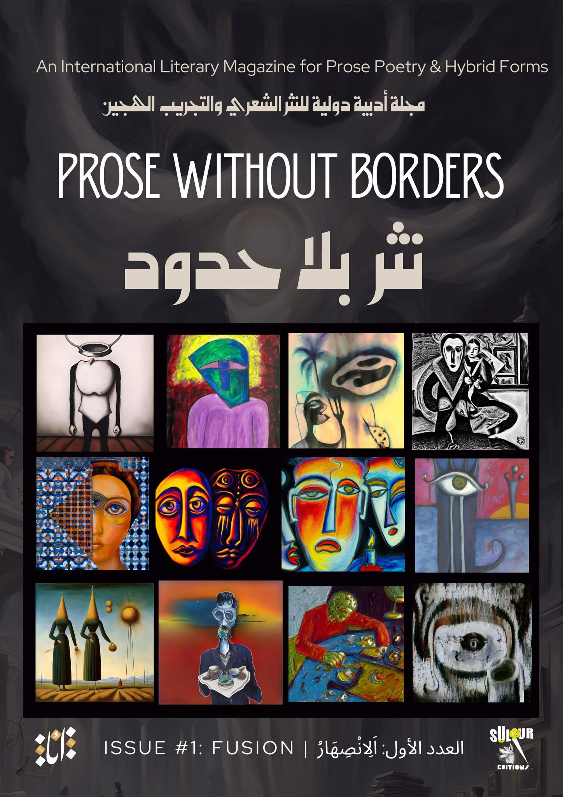
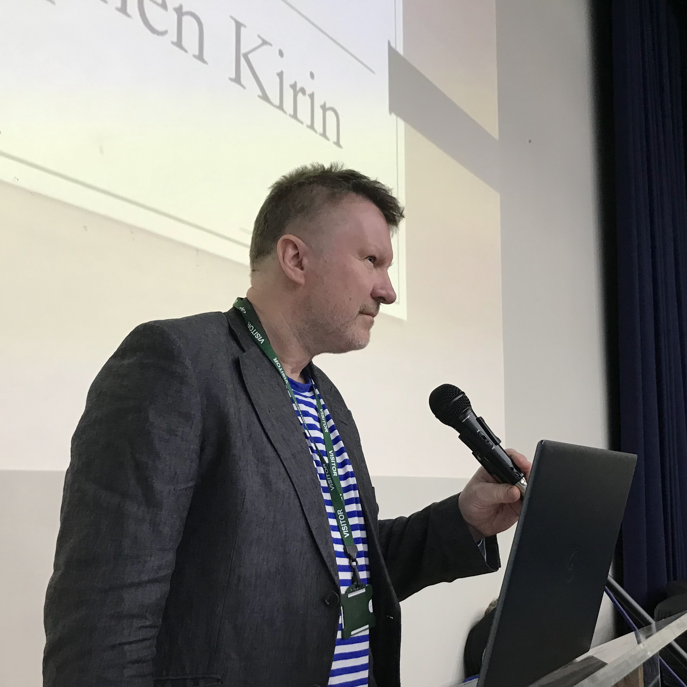

Slide 18
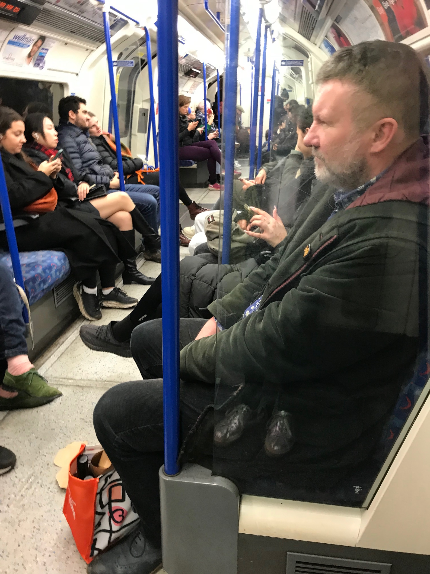
The 8th January
I was asked directions for Paddock Wood
The man said the map
Might as well be Chinese
Chicken and okra on Primrose Hill
My Son’s 24
The tallest person I know
Atop a high point
Systems and structures
Hoving things in place
Despite leaving my hat on the train
And now I stare
At St. Pauls
An horizon of cranes
Lifting the River away
To mop our brows history
The old American pushed the button
To wish the 21st Century
Snow came but wouldn’t stay
And we planned to meet
Again, when the river comes back
Humming cracks
To the blue of you.

Slide 19
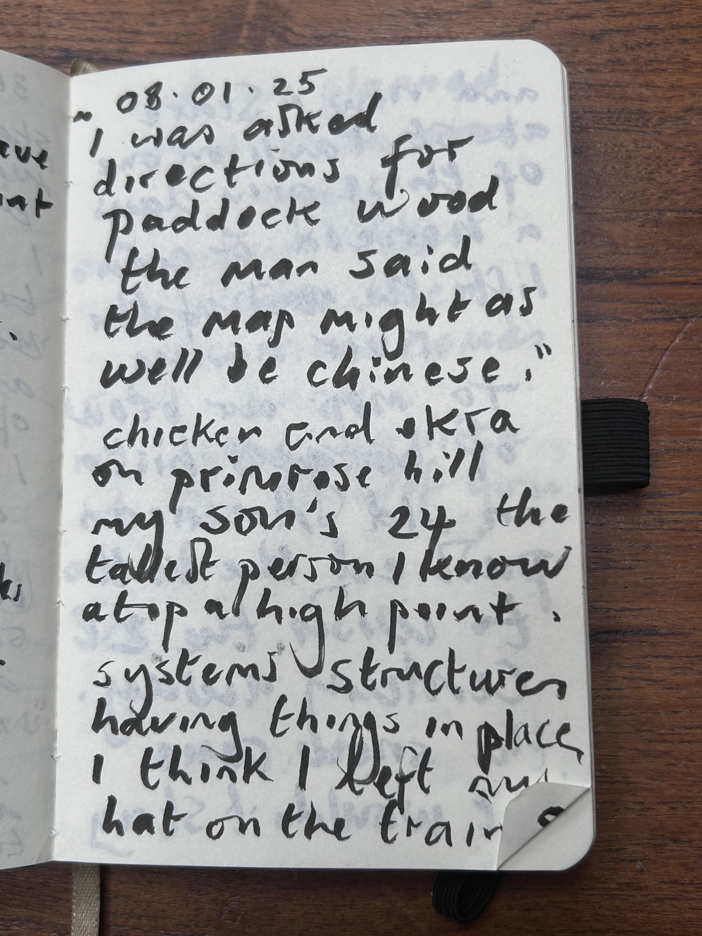
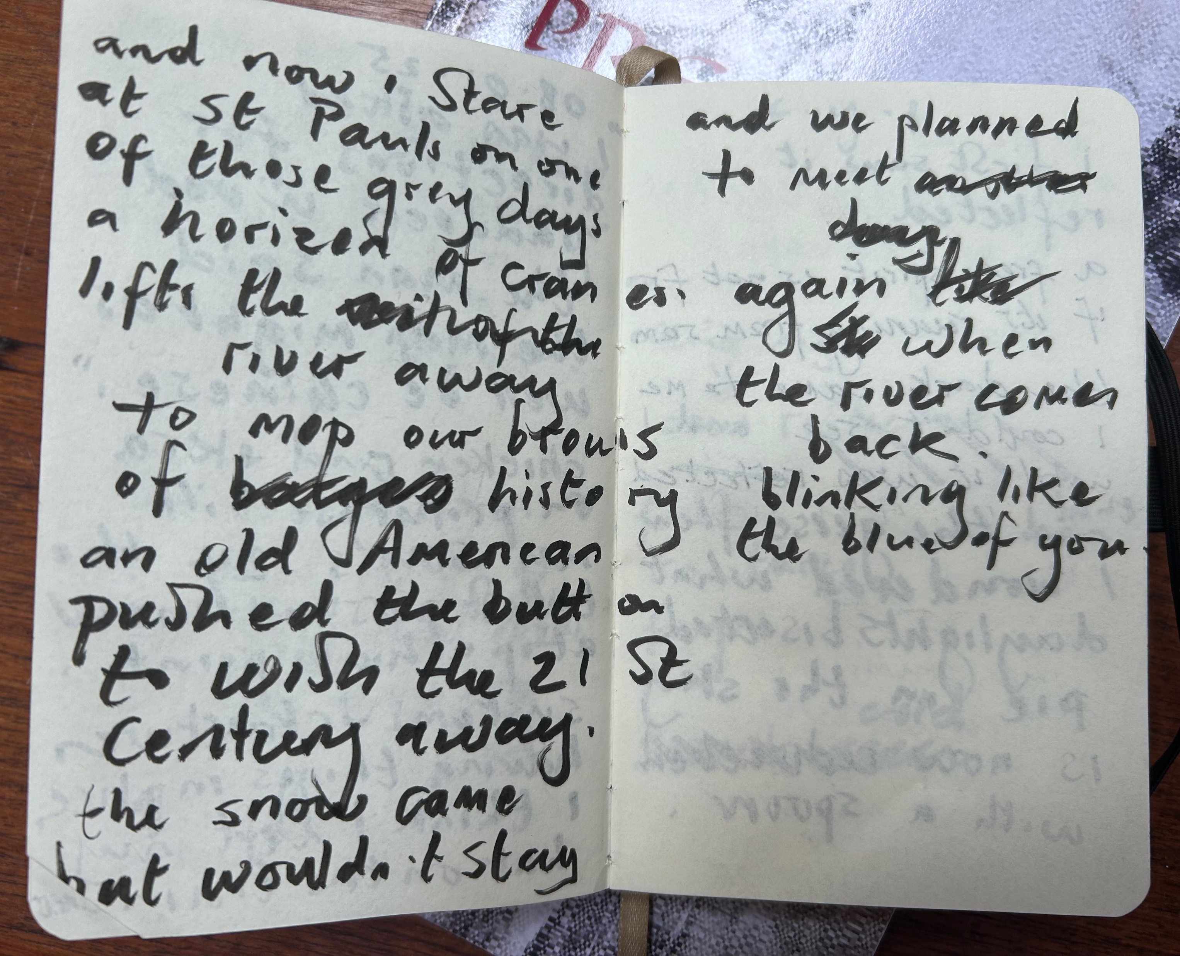

Slide 20
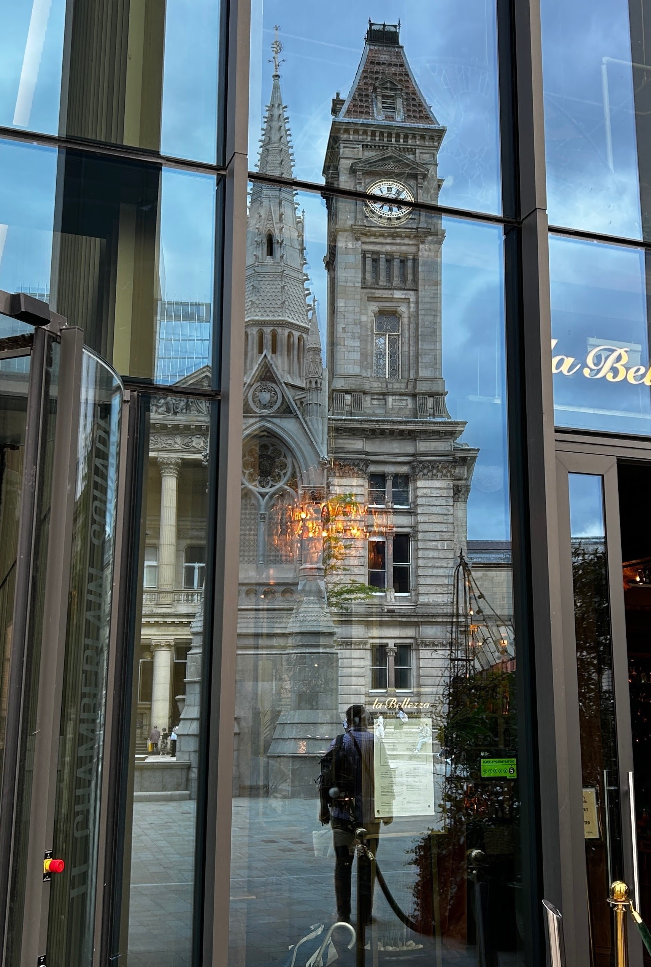
Birmingham day
Birmingham and Fazeley
Lazed canal
Systolic licked the ebb
And flow
Of all the people who go
Past the tombs
That almost disappear
In St Paul’s Square
Where a man smiled
From ear to Chinese New Year
Because the rain
Was nowhere near
The hoard in Staffordshire
Or the board in bed.

Slide 21
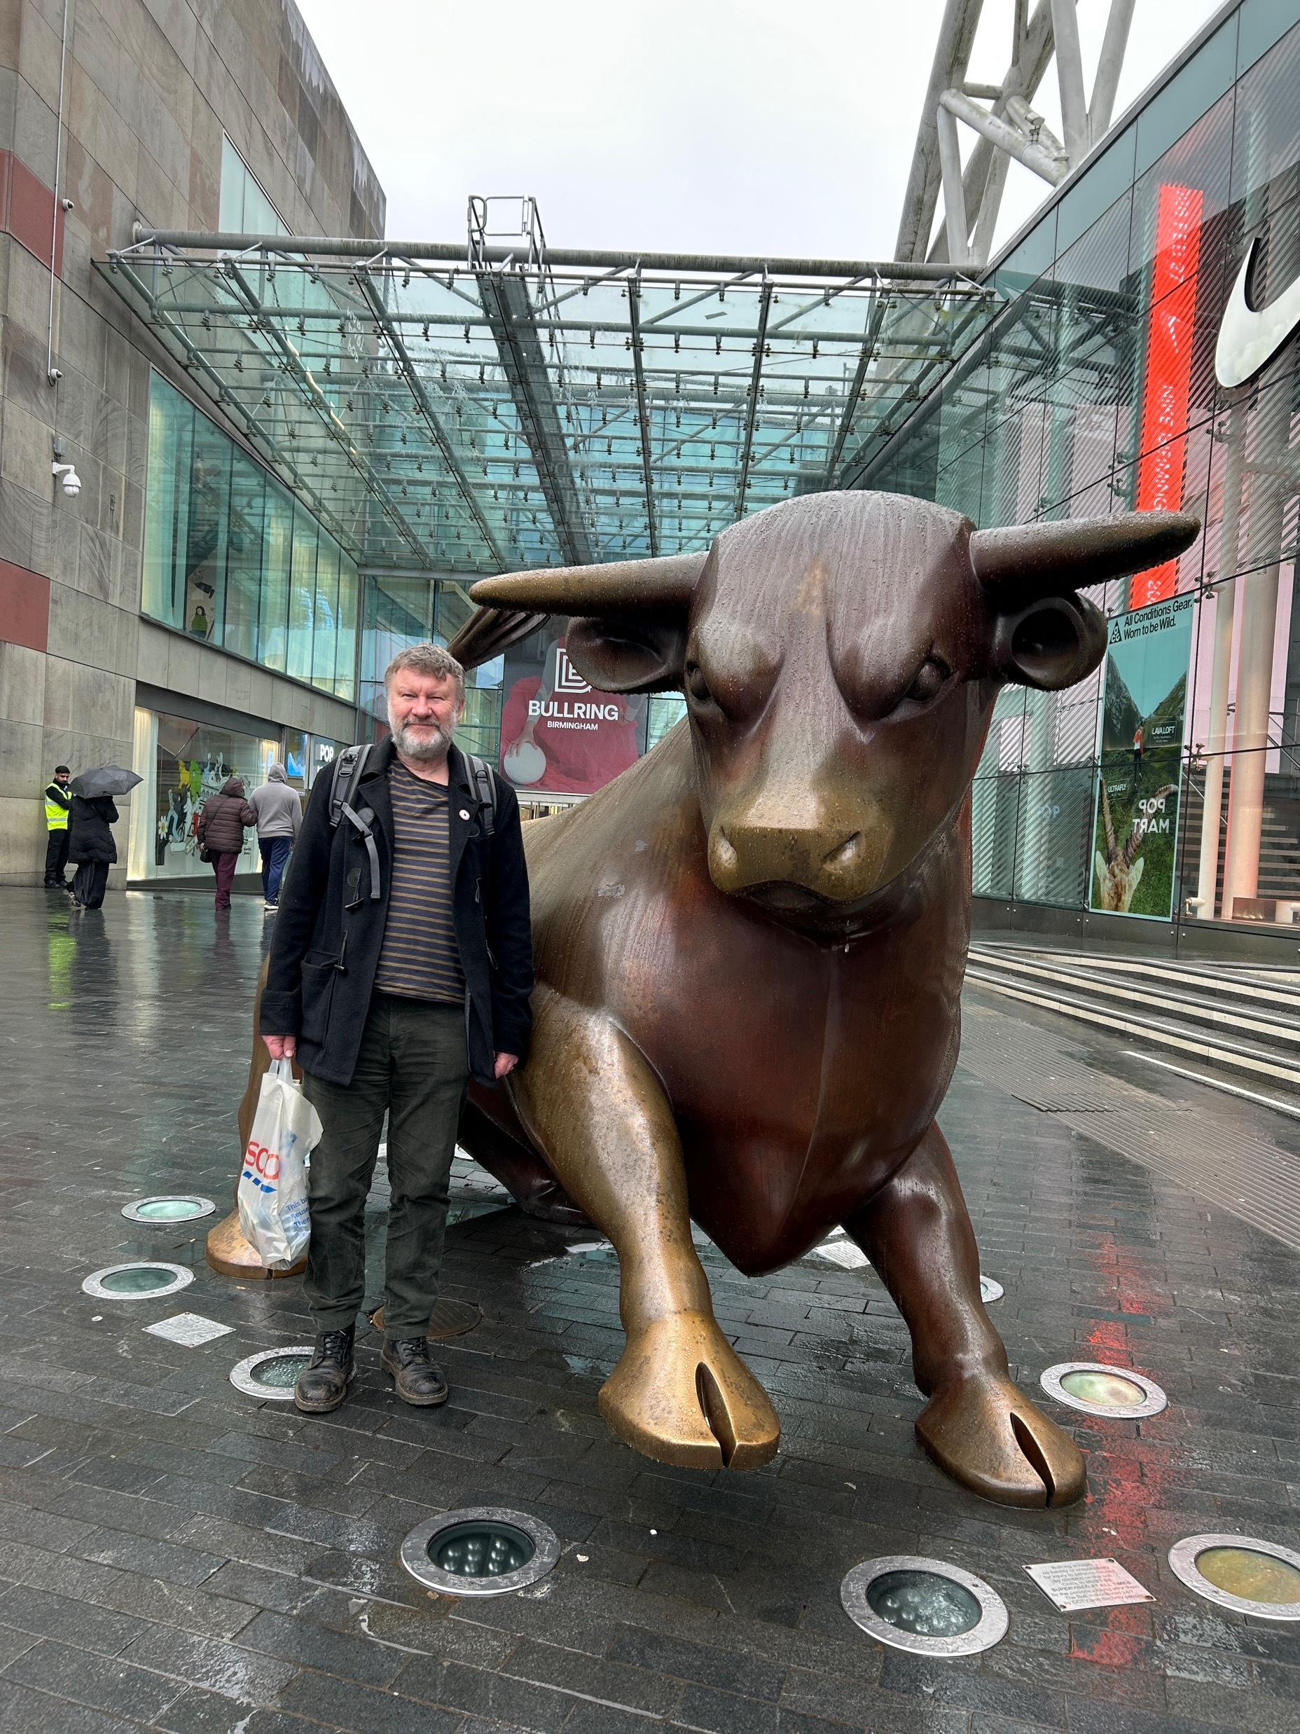
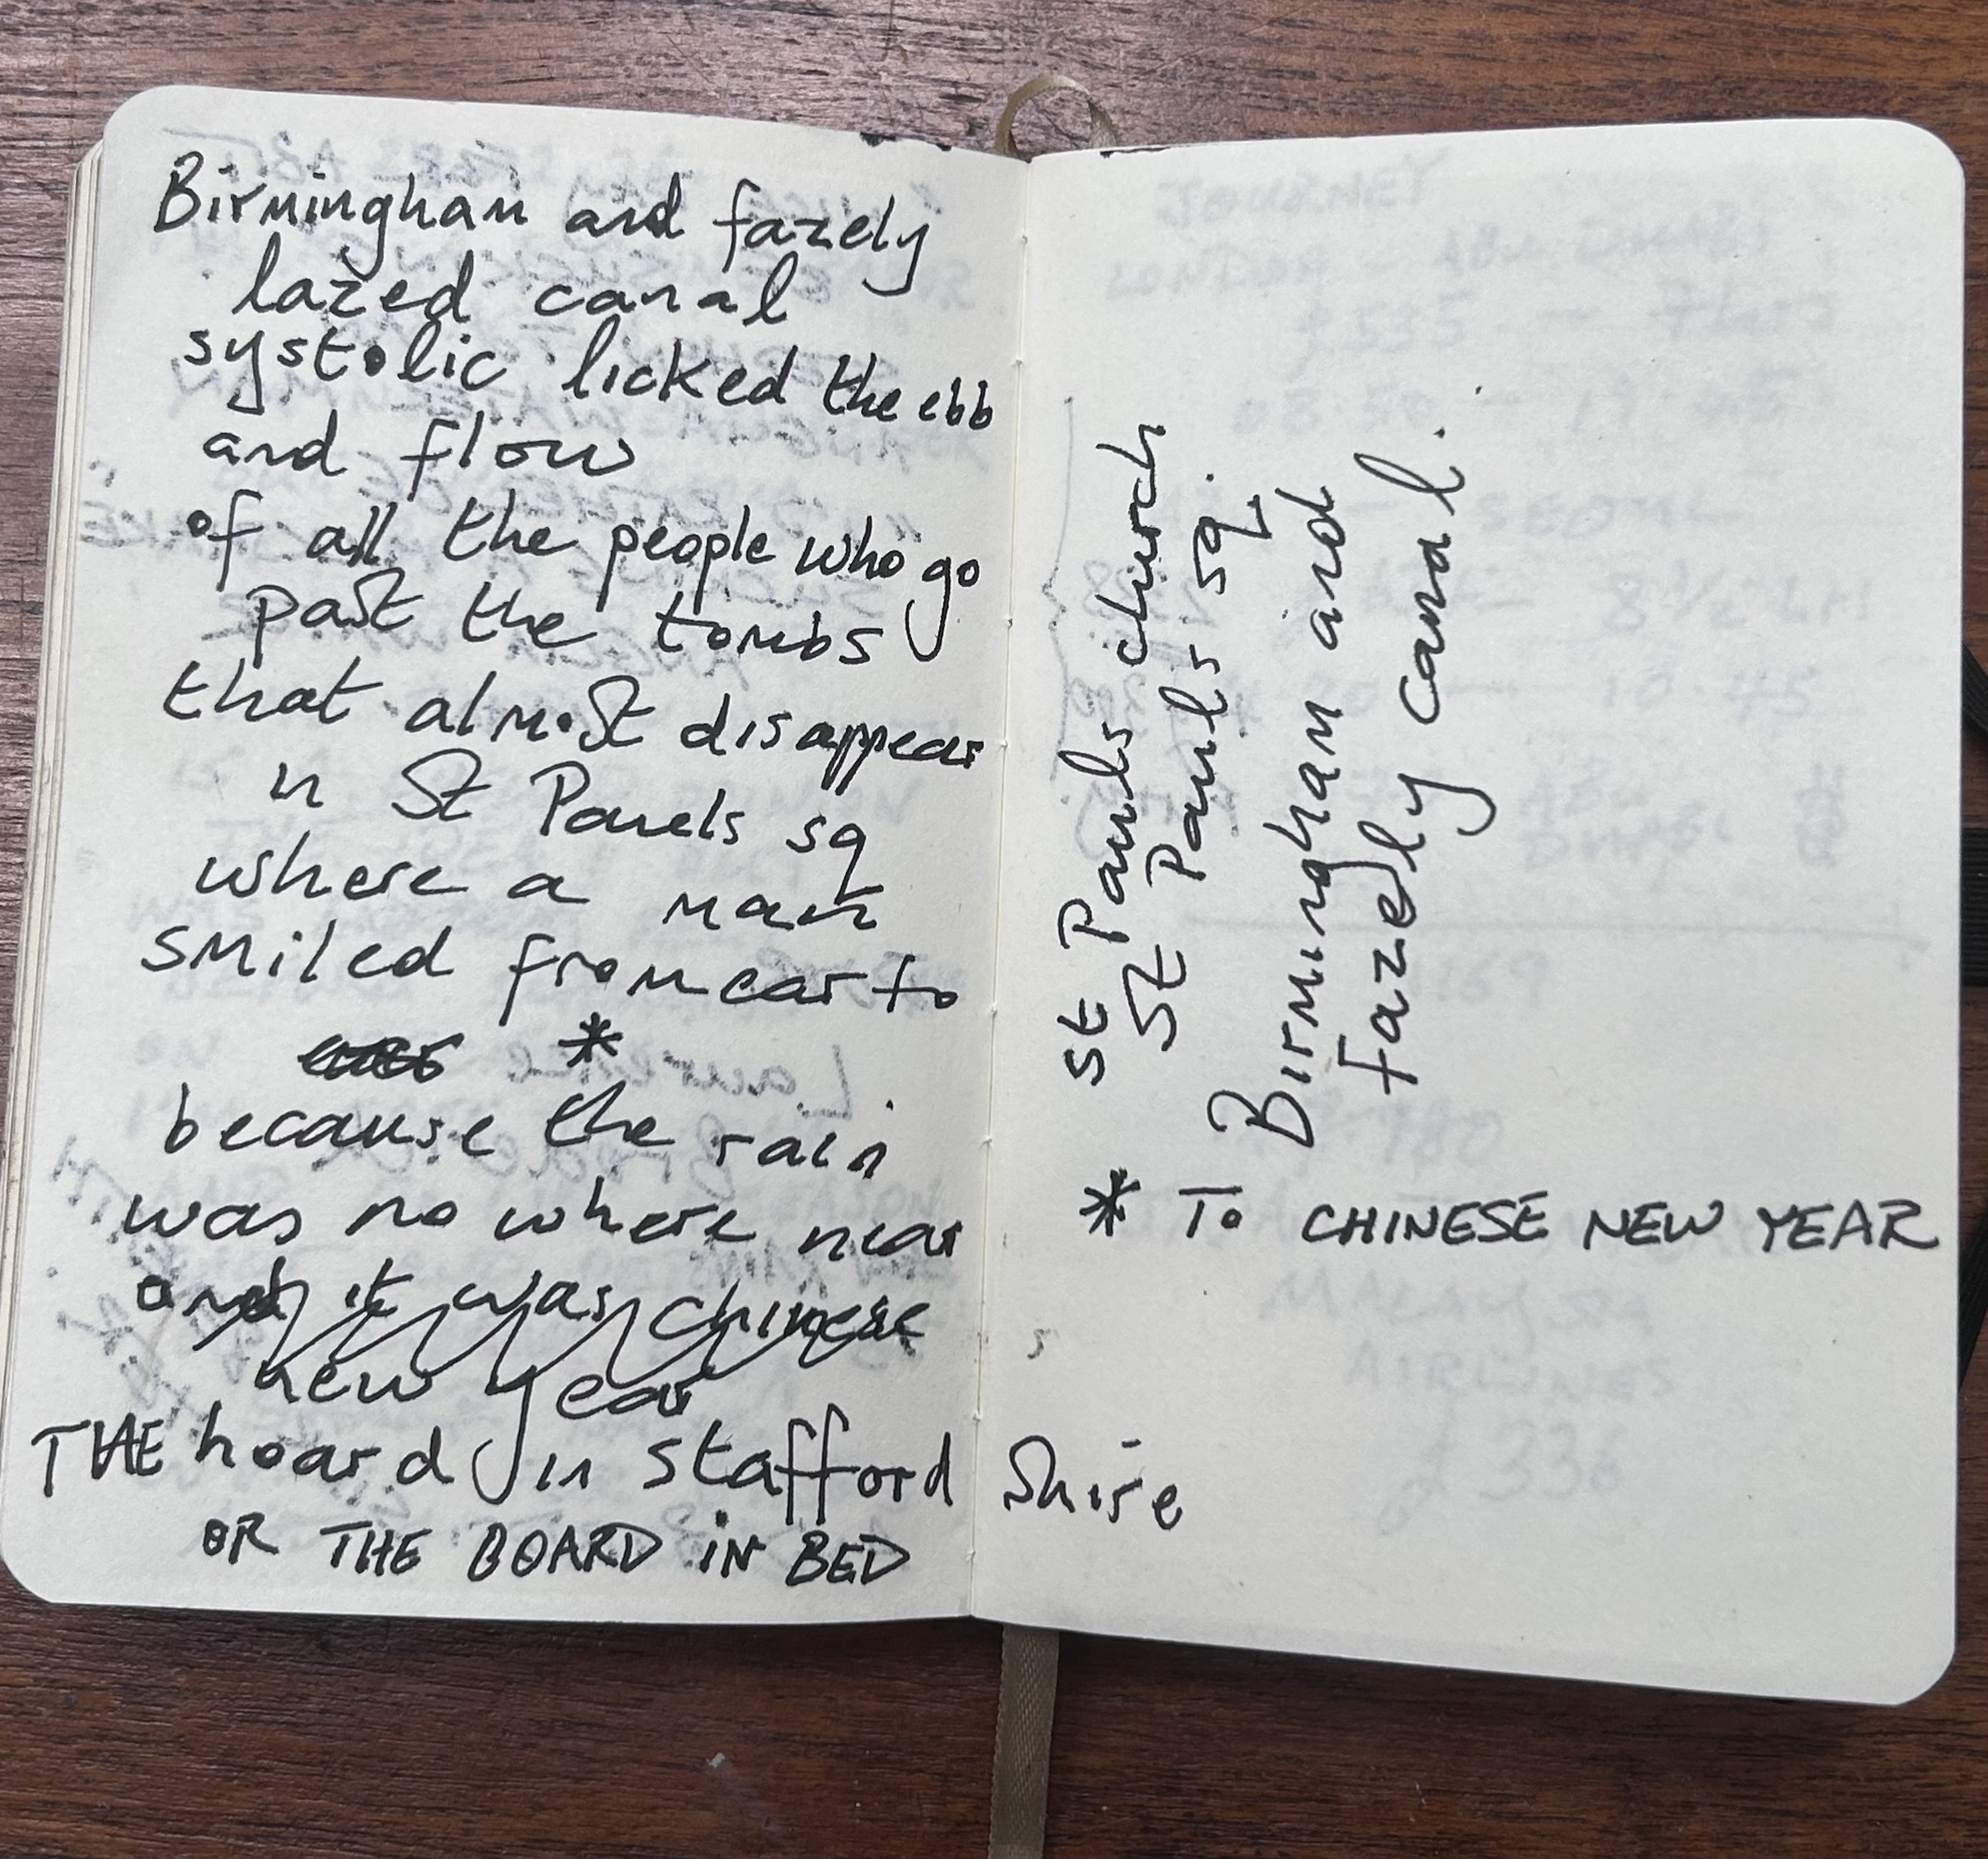

Slide 22
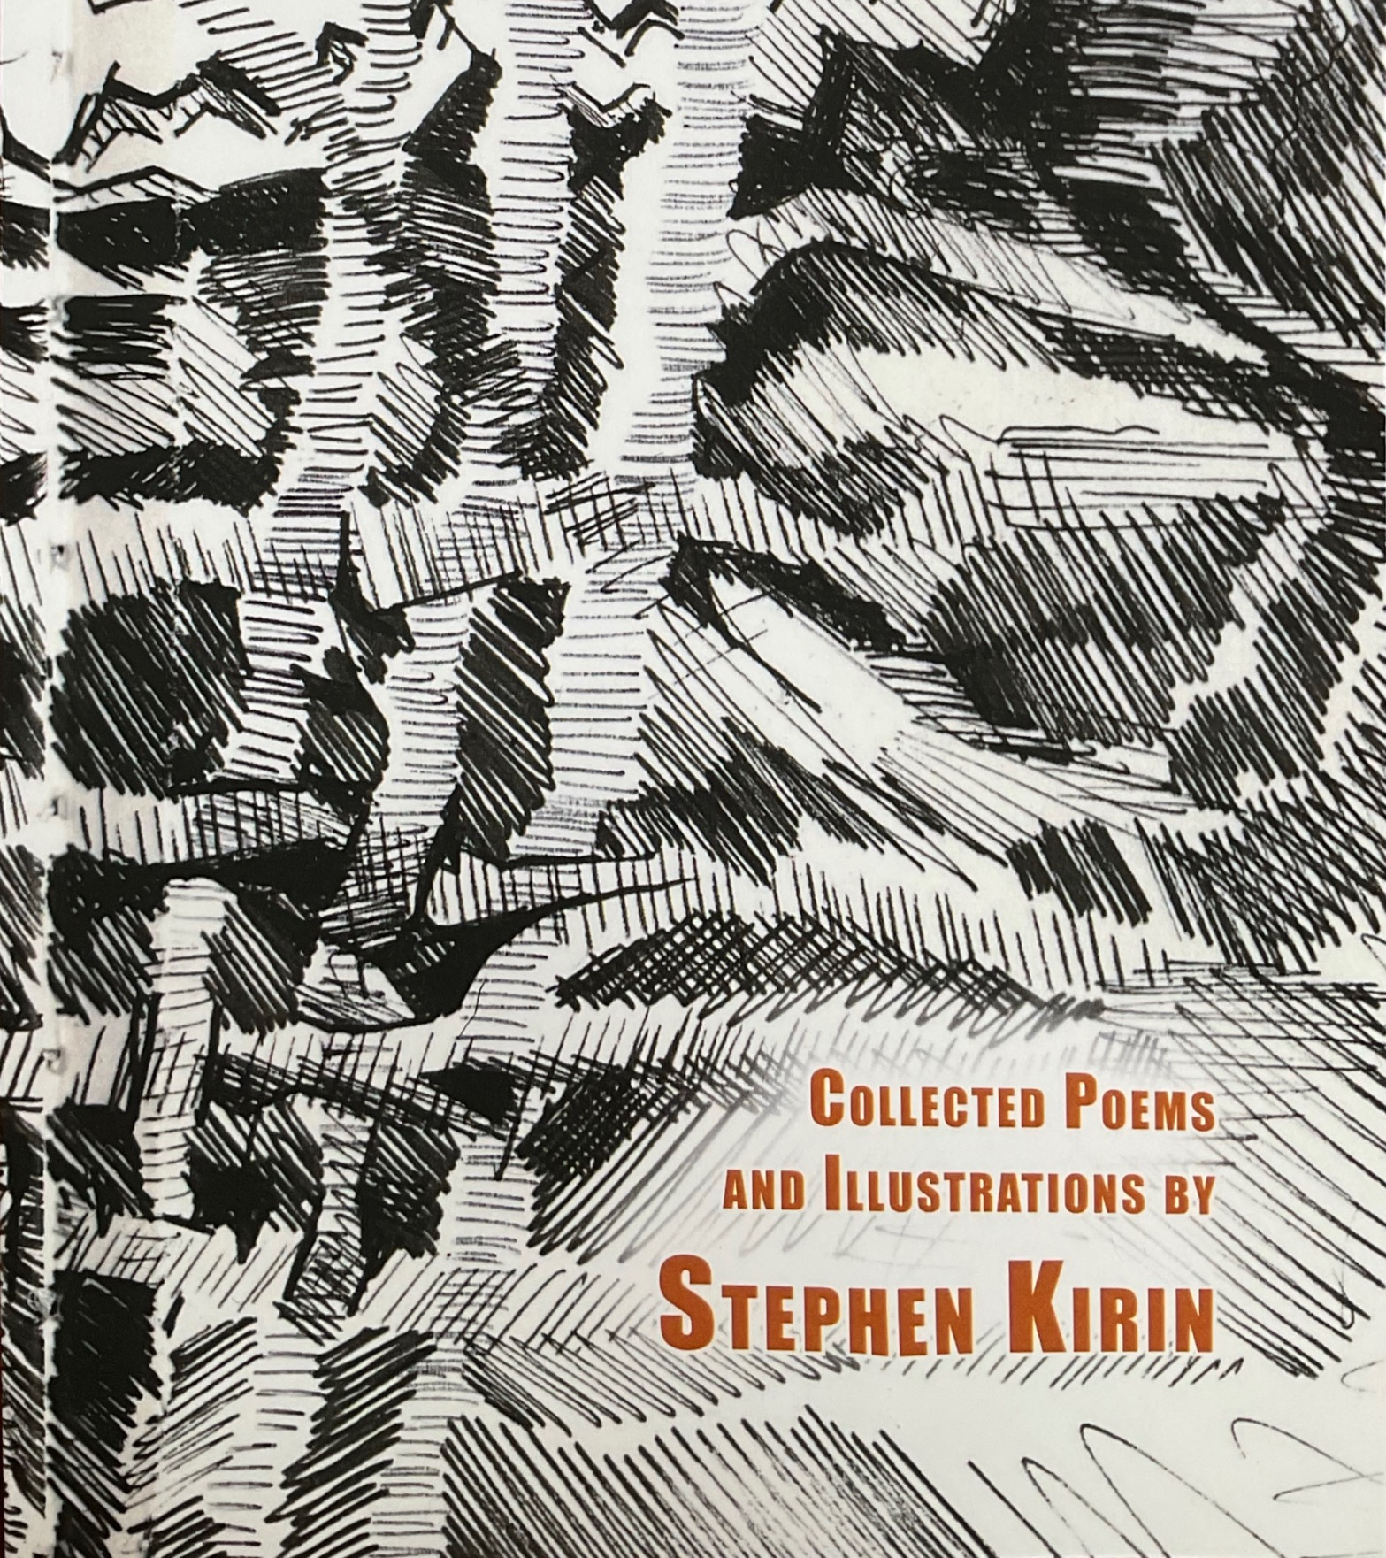

Thank you
www.stephenkirin.com

