Slide 1
Thinking – Walking –Writing – Talking
A talk by Stephen Kirin

Slide 2
WE ARE ALL POETS
We will be looking at what inspired me to write poetry and opening this up for you.
Why poetry is relevant.
Today’s session will generate a new collaborative poem, which will be shared with you all in the near future.
Some of the content is in the boxes you have all so generously contributed to!

Slide 3
THINKING
Where my inspiration began as a teenager
MUSIC! ART! LIFE!
FASTER! FASTER! FASTER!
The earthquake moment

Slide 4
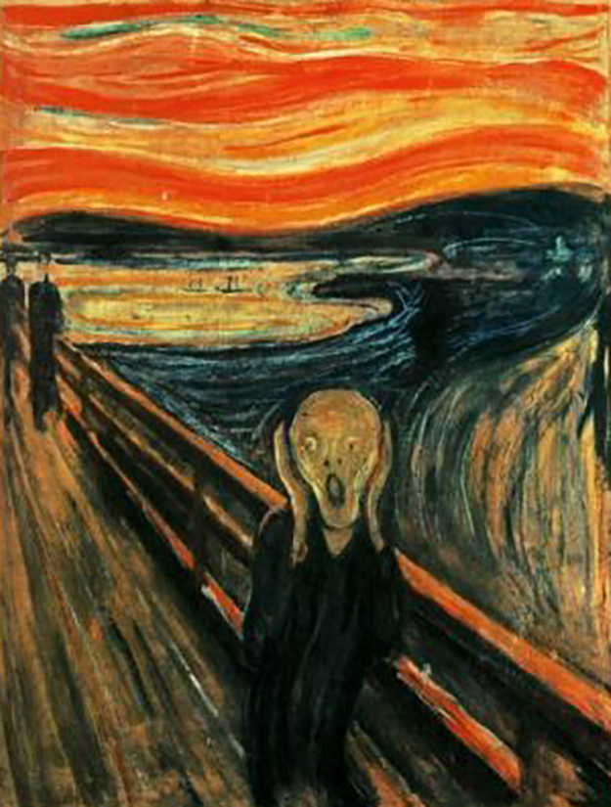
Just one lived experience.

Slide 5
THE SCREAM
“An infinite scream passing through nature”, Edvard Munch (1863 – 1944)
Munch was reported at the time to have said that he heard the scream.
I can trace this as the first time that I realized there was more to Art than met the eye.

Slide 6
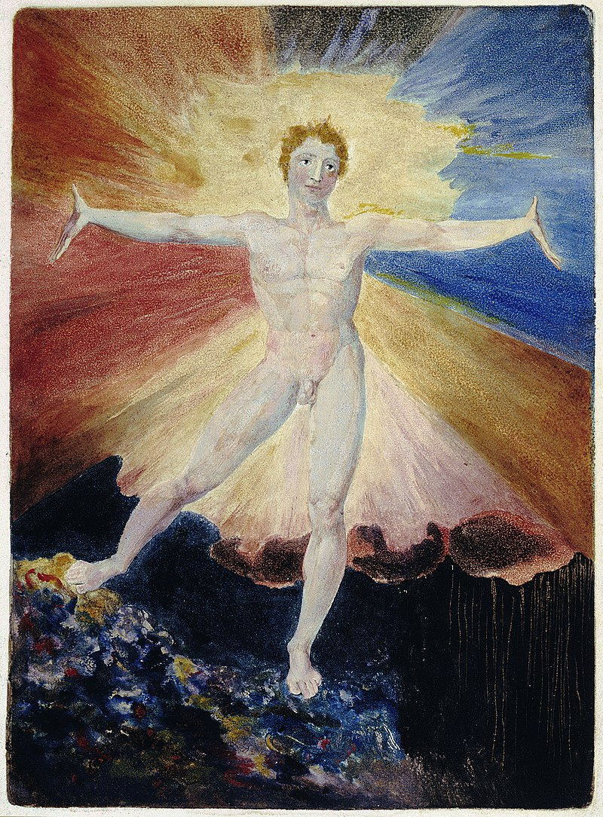
William Blake
1757 – 1827
‘Glad Day’
…virtually the opposite painting to ‘The Scream’?

Slide 7
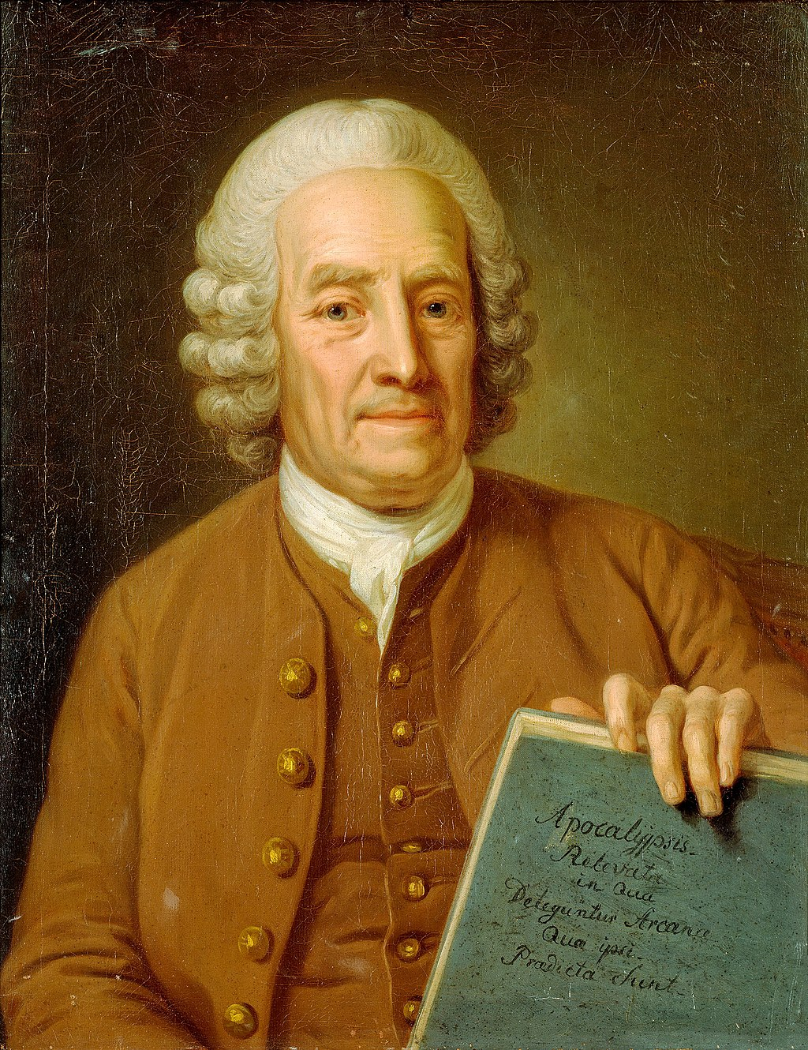
Emanuel Swedenborg
1688 – 1772
“We are physical and spiritual beings simultaneously and can inhabit both worlds”
Both Munch and Blake were inspired by Swedenborg

Slide 8
Why is this important?
How I was inspired, as a young person, by discovering key artists
I was curious enough to keep looking and started to devour everything I could about artists and writers, who were looking at where they were placed in the world and their relationship with it. The timeline runs backwards and forwards.

Slide 9
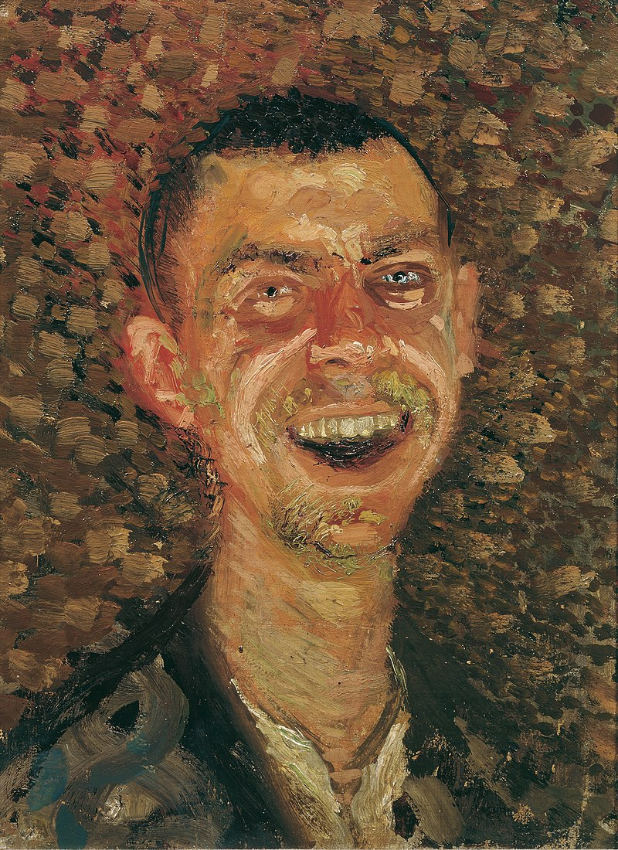
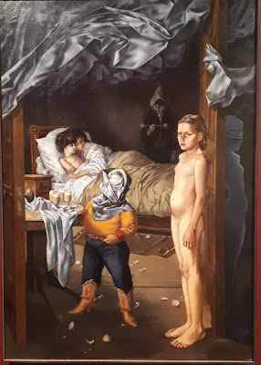
Duality, black and white, light and shade
Dorothea Tanning 1910 – 2012
’Family Portrait’, 1954
Richard Gerstl
1883 – 1908
Self Portrait, 1908

Slide 10
WALKING
You can physically walk and discover things, but you can also walk a line through history.
I had become aware that if I was creative, I was part of something bigger.
I had my own place on the line through art history, whether I wrote, painted or sculpted and I too could be inspired by Munch, Blake and Swedenborg.

Slide 11

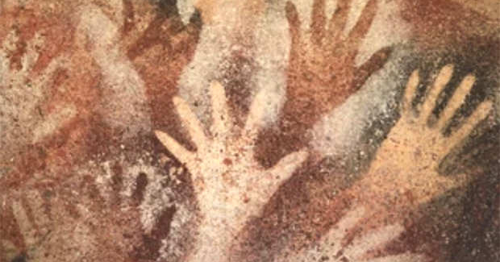

Or walk back 10,000 years along the line

Slide 12
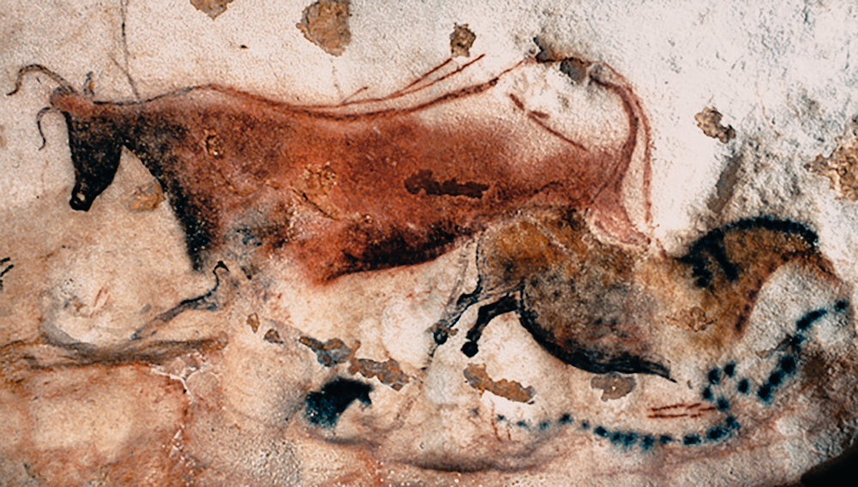
Or walk back 20,000 years along the line

Slide 13
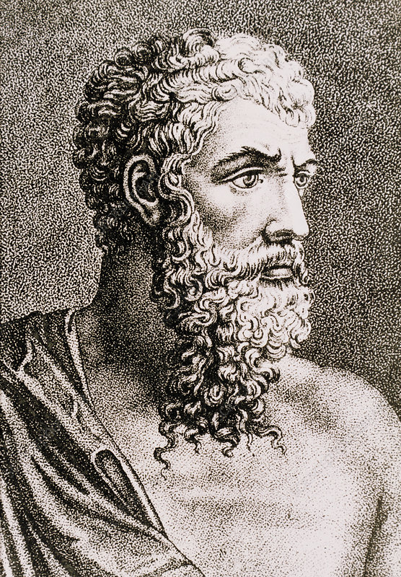
Aristotle
384 – 322 BC
Walk forward 17,500 years from Lascaux…
Metaphysical philosophy.
“How we fit into the Universe, the study of nature and ourselves”

Slide 14
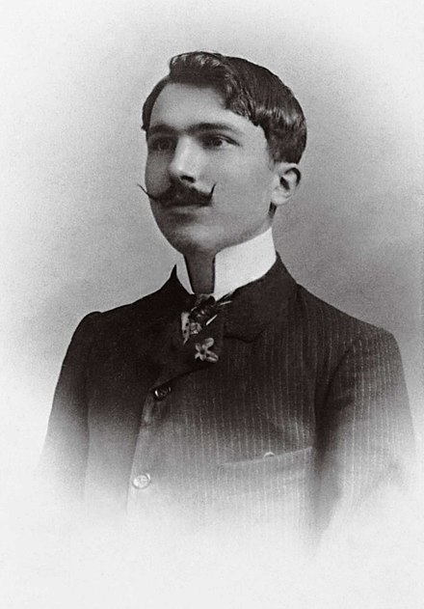
Nikos Kazantzakis
1883 - 1957
Walking forward from Aristotle to Nikos.
Existentialism.
Not how we fit into the Universe, but how the universe fits into us.

Slide 15
“I fear nothing, I hope for nothing, I am a free man”
Nikos Kazantzakis

Slide 16
Q: What do I take from Existentialism?
A: Authenticity

Slide 17
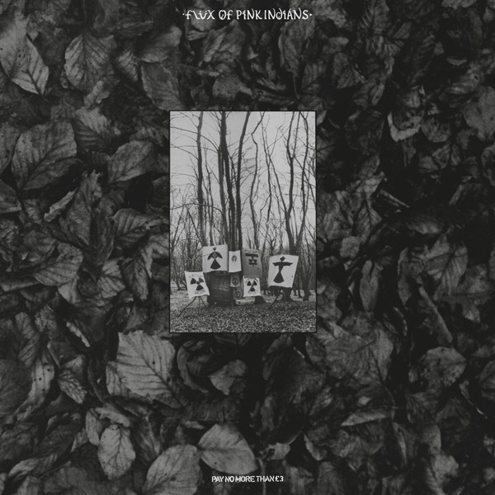
Flux of Pink Indians
‘Strive To Survive Causing Least Suffering Possible’
Post existentialism is more fluid and possibly less self-pre-occupied?
I count this album as an example of this.

Slide 18
WRITING
Writing poetry can be about all of this and always has been.
My inspiration to write is about being on the line that I’m walking. Whether I am walking with Munch, Swedenborg, an indigenous inhabitant of Australia or a Neanderthal in France. Whether I am walking with Aristotle or a punk but mainly being authentic and recognizing being part of the whole.

Slide 19

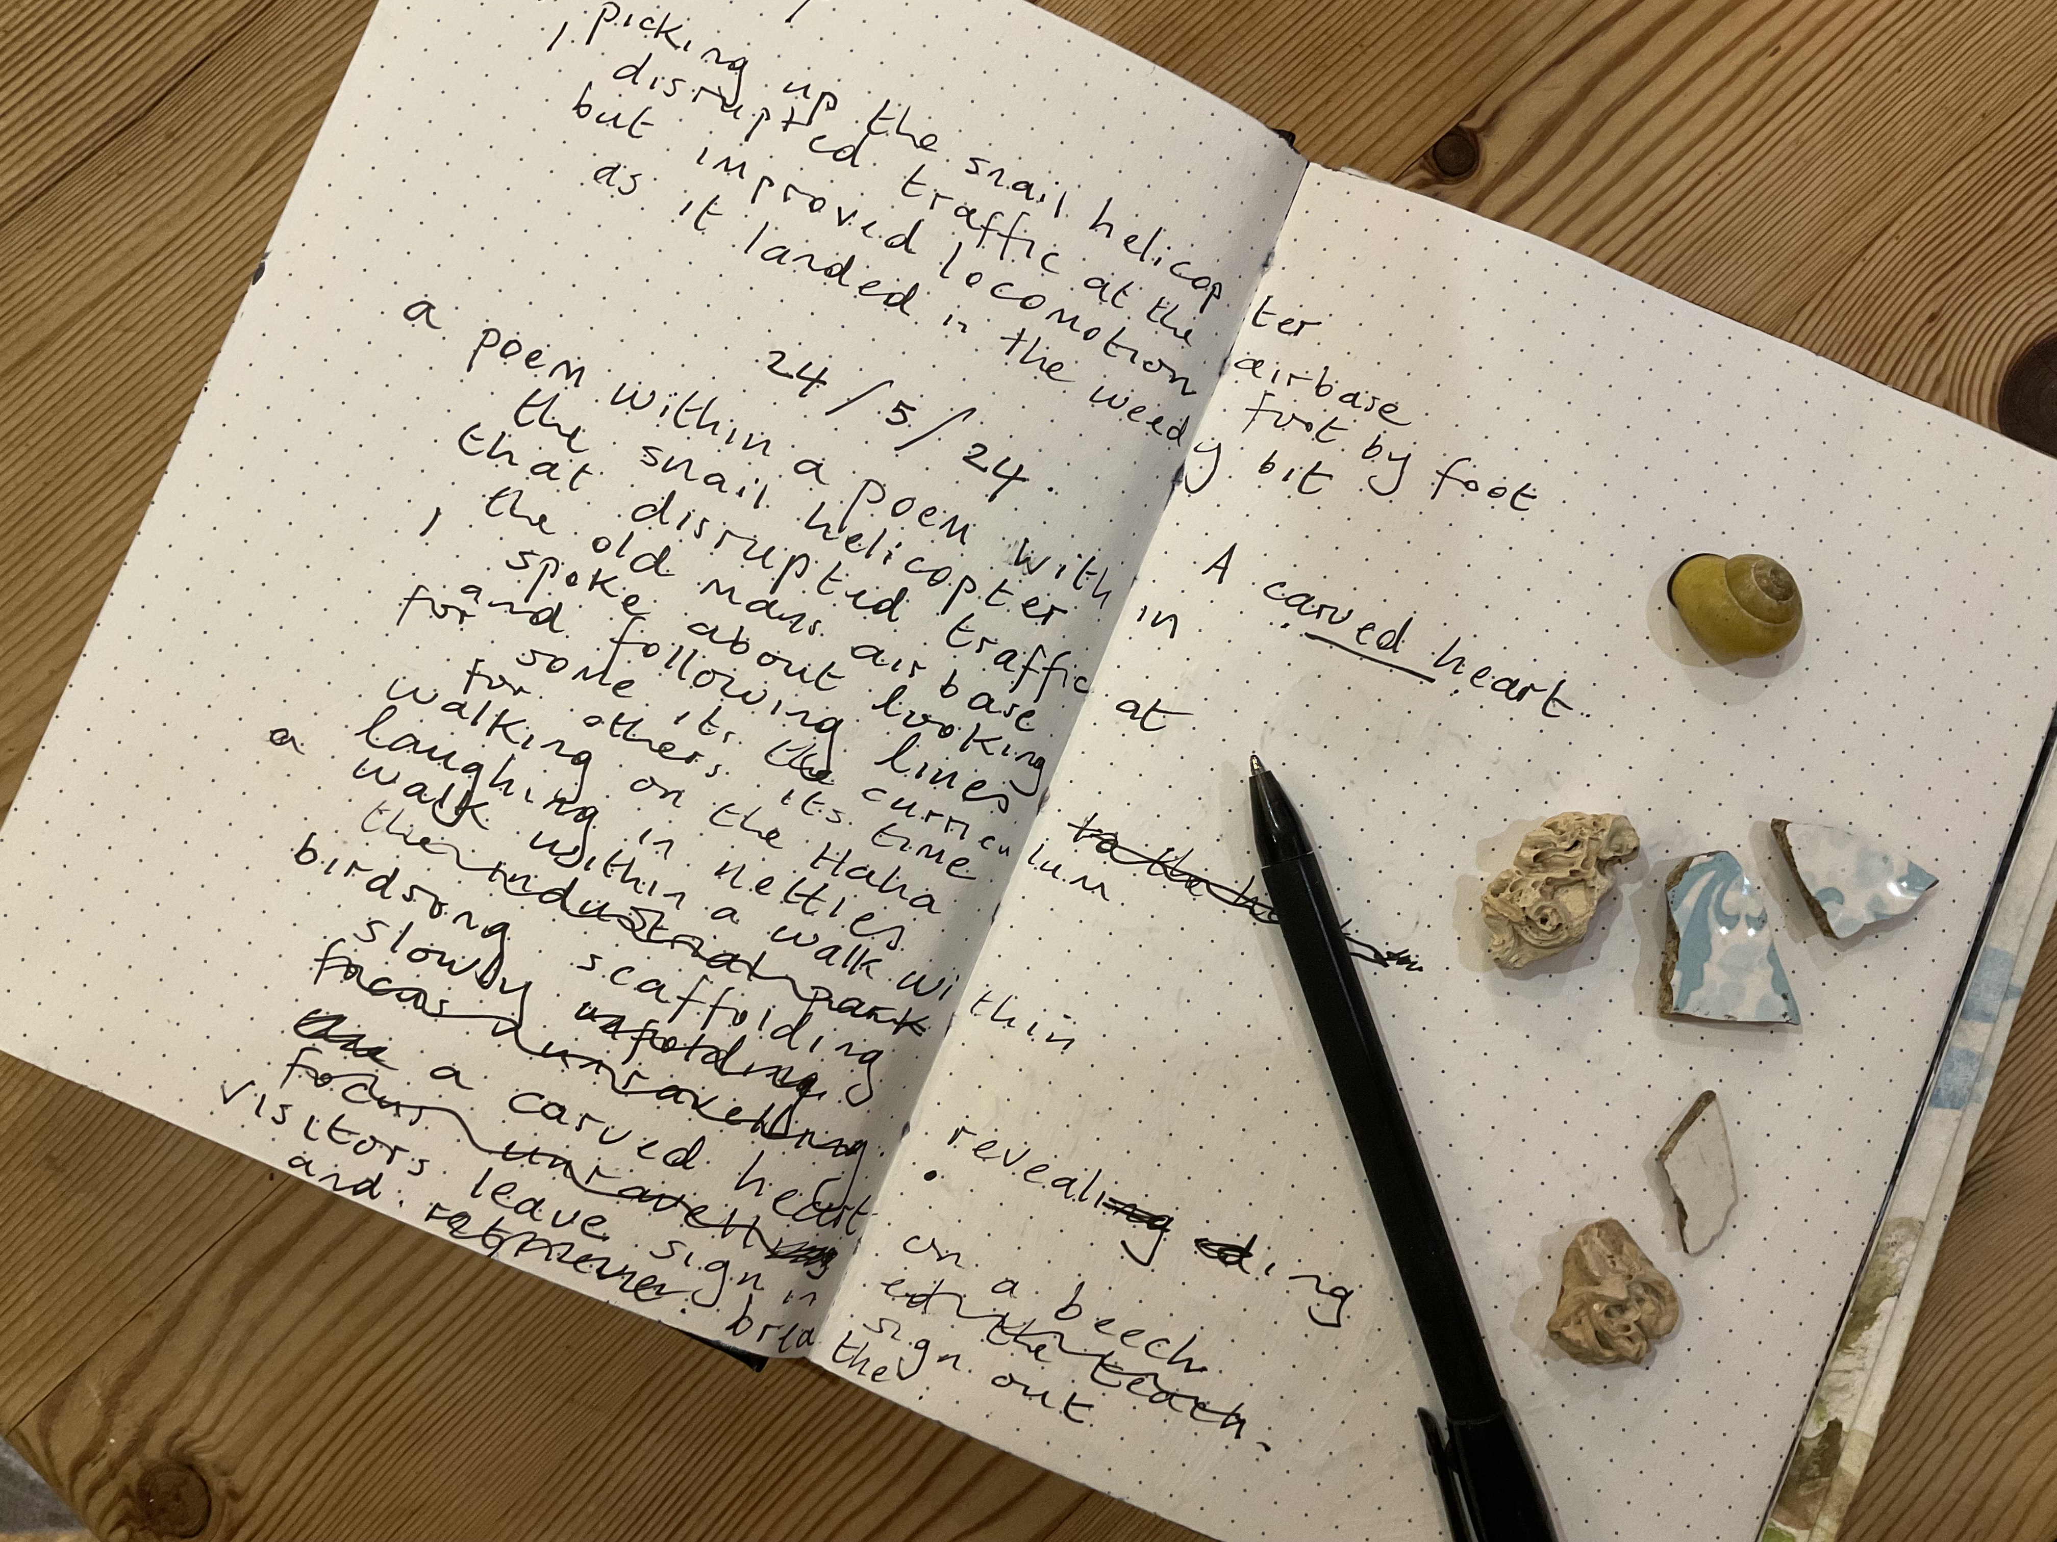
Keep a Notebook
If you don’t make a note of it, you are more than likely to forget it.
Observations about my surroundings, dreams, thoughts and snippets of conversations.
This is where poems come from

Slide 20
TALKING
I’ve been talking, but now it’s time for doing…

Slide 21
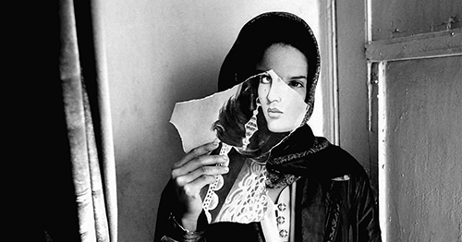
Nadia Anjuman (1980—2005)

Slide 22

A big thank you for having me!
For more information, please visit my website;
stephenkirin.com

